Slide 1


How to Use Your TriMetrix Results to Win at Work, Life, and on the Team

Slide 2
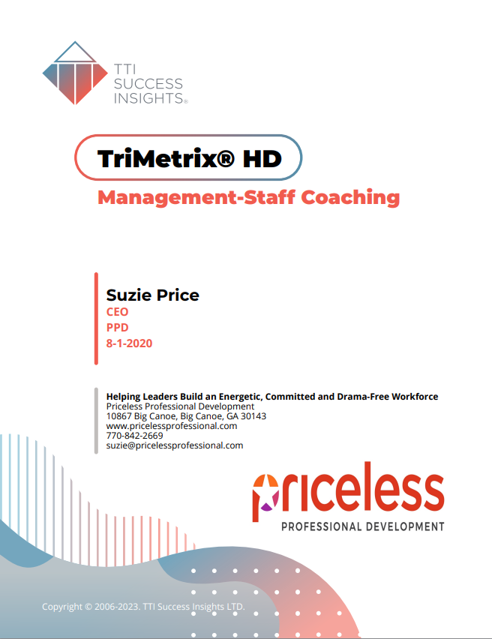

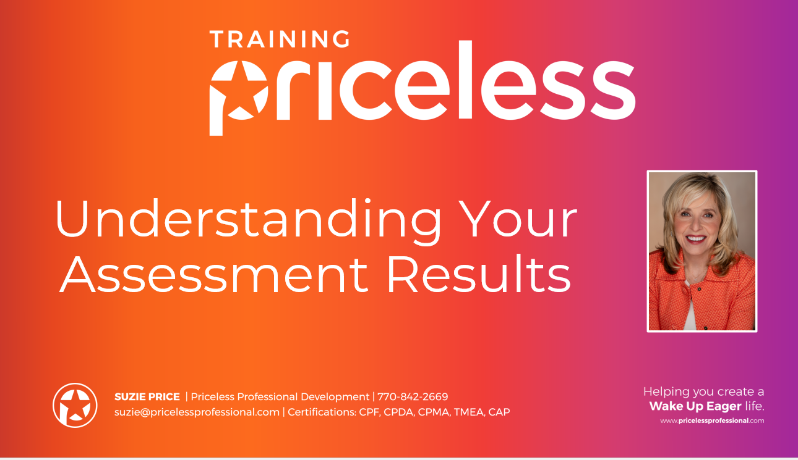


Debrief Video:
www.pricelessprofessional.com/myassessment
Notes:
Did you read the assessment? What were your thoughts? Is anyone willing to share a tweetable comment or two on how you felt about it and what you said to a friend?
Make sure you have your assessment. Afterward, as you go back and re-read your results, check the things you agree with, x the things you are not sure about, and note where you have questions. Reach out to me with any questions.
Did anyone get the chance to watch the strength Revealers debrief video? If not, no worries. Know that you can watch it and find many other communication tools and tips at: www.pricelessprofessional.com/mydiscassessment

Slide 3

QUICK GROUP SHARE:
What You Said and Felt After Reading Your Report…
Notes:
Ask for short statements around what they thought and how they felt after reading their results and watching the debrief video. What did you say to a family member, colleague or friend? (Encourage all thoughts, even if you did not agree with the assessment. You want to make sure they can feel free to question it, as well as embrace it.)

Slide 4
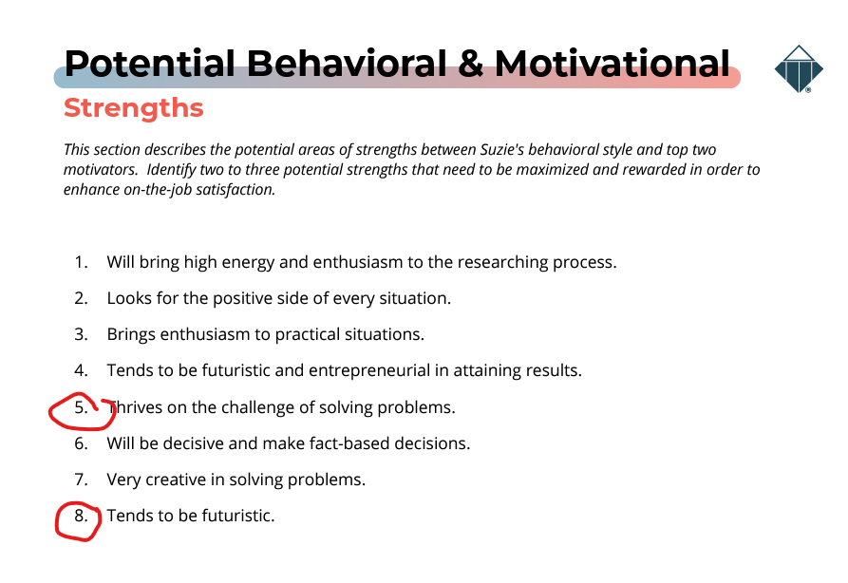
Sharing
Go to @ page _____
“Potential Behavioral
& Motivational Strengths”
Pick two at-work strengths
that stands out right now.
Share ONE right now
and the other later.
1. Share what you picked and why.
2. Share how these strengths could help the team and the company.
Notes:
Now, open your report and go to page (check page number) Potential Behavioral and Motivational Strengths.
Look at the items listed there, and pick the two most important to you. Think about how those items help the team.
FACILITATOR NOTES: If you have enough time, ask each group member to pick their favorite out of the two they selected and share it with the group. Make sure they share what they liked and how they think this strength helps the team. Note people are not always comfortable talking about their strengths, and you may want to comment about that as it sets up what's coming in the next slide. You can also create breakout rooms on Zoom or in person – pairing two people to discuss.)

Slide 5

“When I get to do what I do best every day…”
8%
6X
44%
3X
38%
Notes:
Your strengths matter.
According to the Gallup organization’s extensive research:
- When you know what your strengths are, you are 8% more effective and productive than you were before you were not clear on your strengths.
- When you use your strengths on the job every day, you are six times more likely to be engaged in your work, and you're three times more likely to report that you have a high-quality life.
- The Gallup organization also discovered that teams where each member can say that they get to do what they do best every day, Those teams of 25 people have 44% higher customer service scores and 38% higher productivity.
Your Strengths matter, and we're focusing on them today by looking at how this assessment reveals our strengths and how we can understand our different strengths. It also reviews potential blind spots, which are usually overuse of a strength.

Slide 6

Three out of Four Adults:
  Do not know what their strengths are…
Notes:
Strengths are essential to success.
Unfortunately, so many adults do not know their strengths. According to the Gallup organization, three out of four adults cannot name their strengths, and if they don’t know what their strengths are, they're probably not using them on the job every day. It's no surprise that we have so much disengagement at work today.
We want to use these assessment results to help you name and claim your strengths and gain some of the benefits as a team of having everyone use their strengths on the job every day.

Slide 7
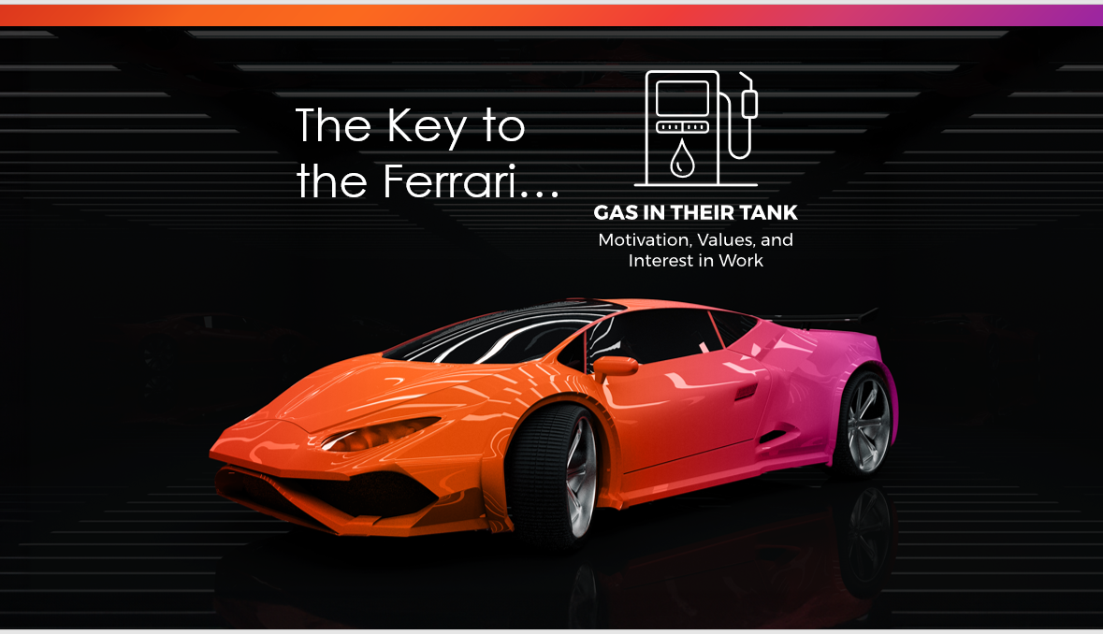


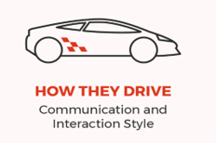


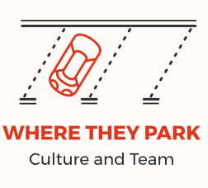
The Key to
the Ferrari…
Notes:
There are five strength revealer focus areas.
We use a car analogy to talk about these areas for easy recall and understanding.
This strength revealer model and the car analogy help you focus on the big picture and help you understand the different aspects measured in the assessment. It is an effective way to understand your performance strengths and potential blind spots. And how you can focus and leverage those strengths in your work every day.
The first strength revealer is roads traveled and plans. This focuses on strengths related to your Background, experience, knowledge, and future goals.
The second strength revealer is our communication style. And that is measured in the assessment in the DISC assessment. In the car analogy, this is how you drive. It is what people see – your communication style and interaction behaviors.
The next strength is gas in tank. This is a measurement of your top motivators and interests. This area is not visible to others, but it is essential. It is what makes us want to act. If a car is out of gas, it is not going anywhere. Motivators are what fill our tank.
There's also an area called horsepower, and it is not immediately visible to others but is the engine of performance. It provides a measurement of 20+ personal skills. Some examples would include self-management, teamwork, and leadership.
And the last strength revealer is where you're parked. This is the impact of the organization and the team’s culture, your team’s leadership, and the team’s collaboration and effectiveness.
Today you’ll learn more about your strengths in the areas related to gas and tank, which is the motivators assessment, and how you drive, which is the disc communication style assessment.
Let’s begin learning more about what is measured in the assessment’s Motivators, Gas in Tank. As a reminder, this area reveals what causes you to want to take action – it is, according to the assessment, your WHY.

Slide 8
WHAT WE WANT TO DO FIVE DAYS A WEEK…
The Key to
the Ferrari…

Slide 9

Personal Reflection Exercise*
1. “I am a (job title) because I…”
2. “I work at (company) because…”
3. “While working at (company) , I want to gain…”
*These answers are private and will not be shared with the group.*
(UTI / AES / IND / SOC / THEO / TRAD))

Slide 10


So, what are Workplace Motivators?
The “Why” of our actions
Drives our choices and decisions
Creates engagement when fulfilled
What is automatically important to you
How you judge people or situations
The arena in which you like to communicate (‘your peeps’)

Slide 11

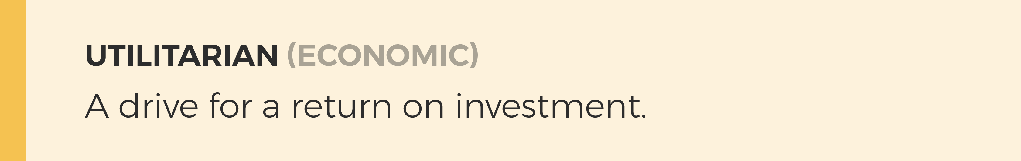
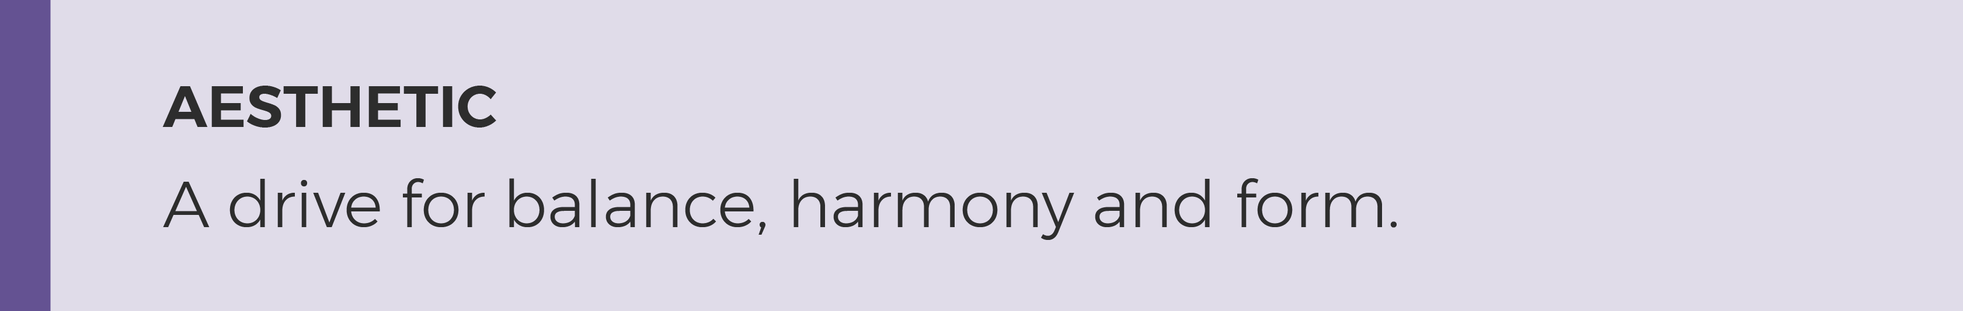
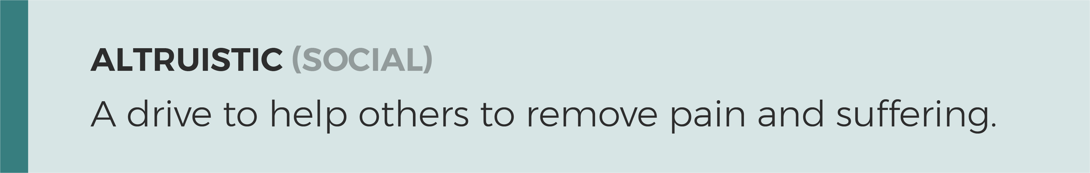
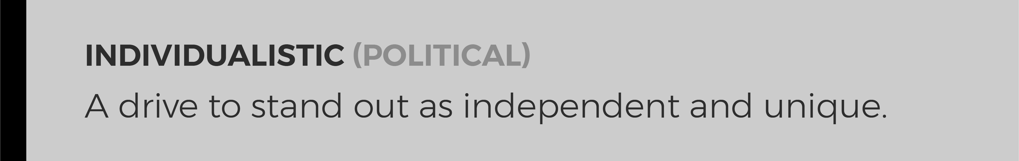
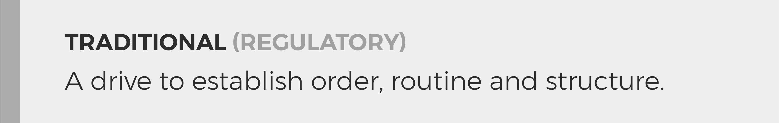
Our top motivators reveal what we are most interested in and how we want to spend our time.
Notes:
There are six culture and gender-neutral motivators, and we probably do a some of each one of these things every day. But all of us have preferences on where we like to spend most of our time. Our preferences were born into us and have been shaped by our environment and experiences. The assessment reveals what we are most INTERESTED in doing five days week, and what we are LEAST interested in doing five days week. And what we are MOST interested in, is what motivates us and puts gas in our tank. This is what we scored #1 and #2. THIS is what motivators us and are some of our top strengths.

Slide 12
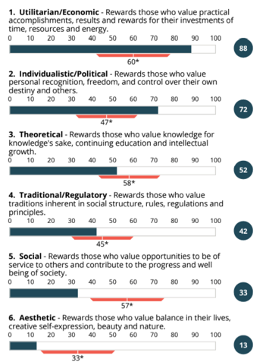
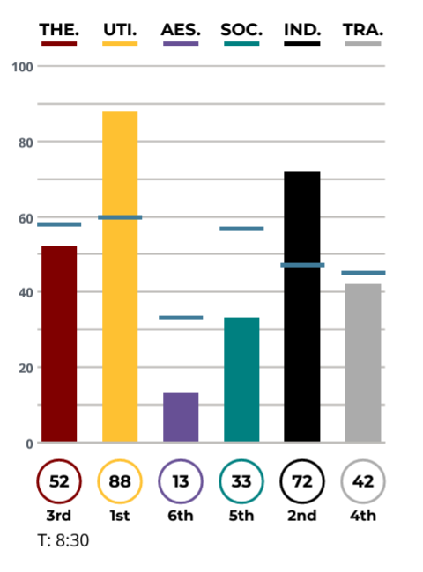
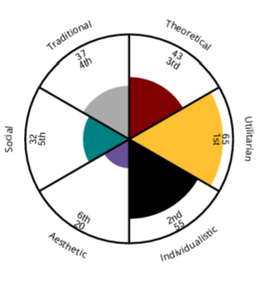
Does NOT measure ability.
DOES measure interest.
My #1 & 2
Most Interested – Energizes Me!
My #6
Least Interested – Could be a Stressor
Drives Behavior
Not easily visible.
Nature, nurture.
P
Goal: Self Awareness, Other Awareness, Understand Energy, Interest and Stress
Notes:
There are six motivators and interests that are measured.
According to the assessment, your #1 and #2 are the areas your are MOST interested in, and your #6 – is the area you are least interested in.
With this science – remember:
That it is measuring something that is not easily visible to others
That all six motivators are equally valuable and add value to the team (one is not more preferred over another)
That this area measures INTEREST, not ability.
FACILITATOR NOTE: Share the Motivators Memory Jogger Card with Participants. Have them open this document or print it out (when we teach we provide laminated copies to participants) and follow along: https://wakeupeager.s3.amazonaws.com/Motivators_MJCard_2021.pdf

Slide 13
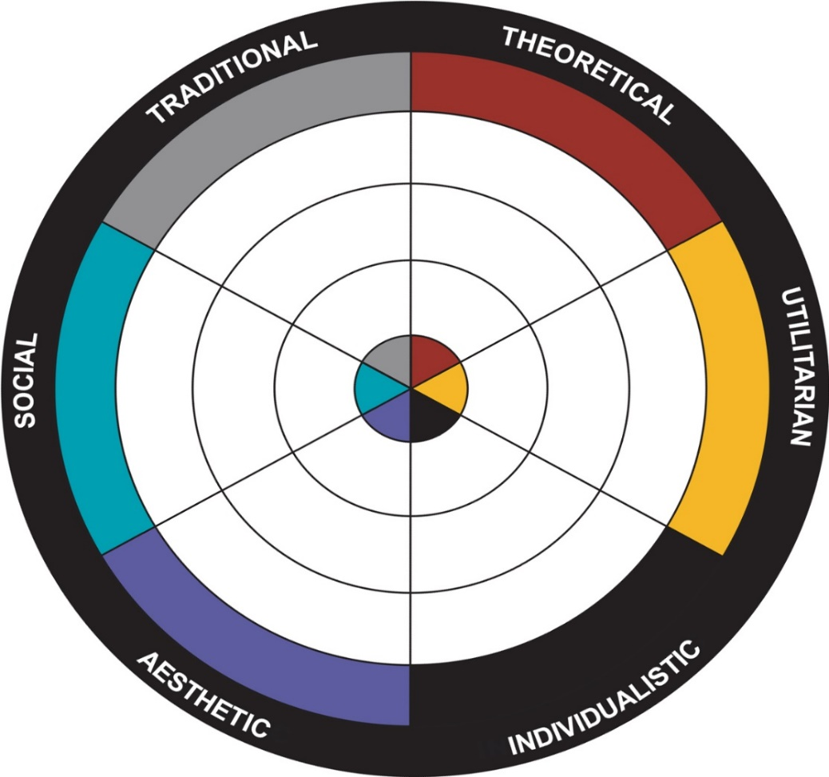

Workplace Motivators: Summary Descriptors
THE PROCESS AND ORDER KEEPER:
Follow and enforce rules, process, structure.
THE LEARNER
Always Questioning,
High Product Knowledge.
#1
#2
Gas in Tank
#6
Empty
Tank
ALTRUISTIC/SERVICE/
HELPING OTHERS:
Generous helper,
remove pain.
THE BUSINESS PERSON: R.O.I.: Money, Reduce waste.
BALANCE AND
HARMONY SEEKER:
Creativity, beauty,
harmony & balance.
THE POWER PLAYER:
Leading, advancing, influence.
Not Visible. ALL Equally Valuable. Measures INTEREST, NOT Ability.
Notes:
There are six motivators and interests that are measured.
According to the assessment, your #1 and #2 are the areas your are MOST interested in, and your #6 – is the area you are least interested in.
With this science – remember:
That it is measuring something that is not easily visible to others
That all six motivators are equally valuable and add value to the team (one is not more preferred over another)
That this area measures INTEREST, not ability.
FACILITATOR NOTE: Share the Motivators Memory Jogger Card with Participants. Have them open this document or print it out (when we teach we provide laminated copies to participants) and follow along: https://wakeupeager.s3.amazonaws.com/Motivators_MJCard_2021.pdf

Slide 14

Your Turn! @ page ___
MOST Interested: Your #1, #2
LEAST Interested: Your #6
#1
#6
#2
Not Visible. ALL Equally Valuable. Measures INTEREST, NOT Ability.
Notes:
Open your assessment and go to page _____ (Make sure they look for the Wheel image.)Write down your #1, #2 and #6.

Slide 15
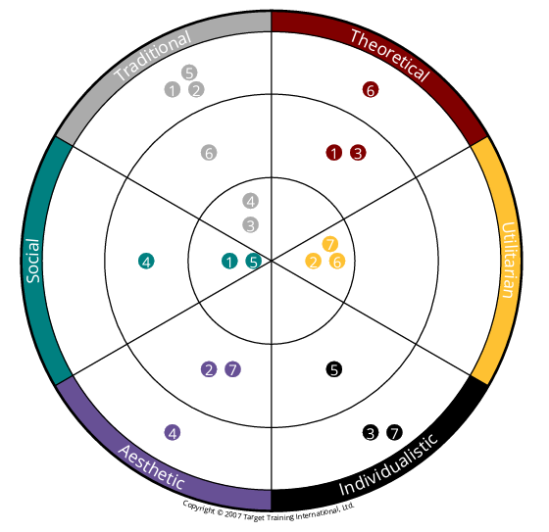
Workplace Motivators: #1 and #2
THE PROCESS AND ORDER KEEPER:
Follow and enforce rules, process, structure.
THE LEARNER
Always Questioning,
High Product Knowledge.
#1
#2
THE BUSINESS PERSON: R.O.I.: Money, Reduce waste.
ALTRUISTIC/SERVICE/
HELPING OTHERS:
Generous helper,
remove pain.
According to the Assessment:
My #1, #2 =
Most Interested
BALANCE AND
HARMONY SEEKER:
Creativity, beauty,
harmony & balance.
THE POWER PLAYER:
Leading, advancing, influence.
Notes:
Let’s start with you looking for your #1 motivator and interest . According to the assessment, this is what puts gas in your tank. See where you landed and then review the MJ Card.
(ASK) What insights do you see? Is there anything that seems like “ah-ha” “makes sense” or “well that’s a surprise…” Anyone willing to share?
Now look for your #2 (ASK) What insights do you see? Is there anything that seems like “ah-ha” “makes sense” or “well that’s a surprise…” Anyone willing to share?
(ASK) If this is accurate and it is insight into what fills your tank – how could you use this insight daily? How could you use it on this team?
Let’s look at the Team Overall – the area where the team has the most interest is in (CHANGE For EACH TEAM -Theoretical/Knowledge…) (ASK) Does this work for our team and the work we do? What strengths does it show that we bring? (refer to Memory Jogger card) What could be potential blind spots? How are we currently covering the blind spots? What else do we need to be doing more of or less of?
The next area is (CHANGE For THE TEAM) (ASK) Individualistic/Political the Power Player - Does this work for our team and the work we do? What strengths does it show that we bring? (refer to Memory Jogger card) What could be potential blind spots? How are we currently covering the blind spots? What else do we need to be doing more of or less of? Now, let’s look at what each individual rated as their LEAST Interest…

Slide 16
Workplace Motivators: #1 and #2
THE PROCESS AND ORDER KEEPER:
Follow and enforce rules, process, structure.
THE LEARNER
Always Questioning,
High Product Knowledge.
#1
#2
THE BUSINESS PERSON: R.O.I.: Money, Reduce waste.
ALTRUISTIC/SERVICE/
HELPING OTHERS:
Generous helper,
remove pain.
According to the Assessment:
My #1, #2 =
Most Interested
BALANCE AND
HARMONY SEEKER:
Creativity, beauty,
harmony & balance.
THE POWER PLAYER:
Leading, advancing, influence.
Notes:
Let’s start with you looking for your #1 motivator and interest . According to the assessment, this is what puts gas in your tank. See where you landed and then review the MJ Card.
(ASK) What insights do you see? Is there anything that seems like “ah-ha” “makes sense” or “well that’s a surprise…” Anyone willing to share?
Now look for your #2 (ASK) What insights do you see? Is there anything that seems like “ah-ha” “makes sense” or “well that’s a surprise…” Anyone willing to share?
(ASK) If this is accurate and it is insight into what fills your tank – how could you use this insight daily? How could you use it on this team?
Let’s look at the Team Overall – the area where the team has the most interest is in (CHANGE For EACH TEAM -Theoretical/Knowledge…) (ASK) Does this work for our team and the work we do? What strengths does it show that we bring? (refer to Memory Jogger card) What could be potential blind spots? How are we currently covering the blind spots? What else do we need to be doing more of or less of?
The next area is (CHANGE For THE TEAM) (ASK) Individualistic/Political the Power Player - Does this work for our team and the work we do? What strengths does it show that we bring? (refer to Memory Jogger card) What could be potential blind spots? How are we currently covering the blind spots? What else do we need to be doing more of or less of? Now, let’s look at what each individual rated as their LEAST Interest…

Slide 17
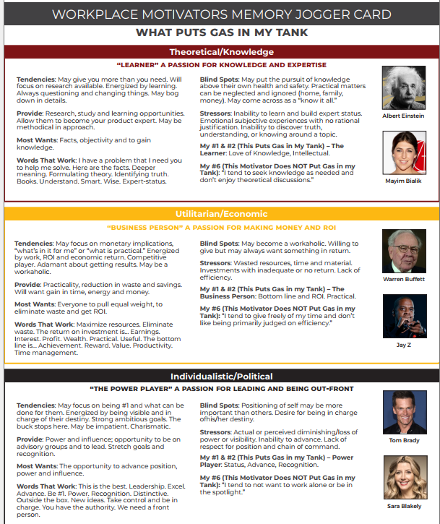
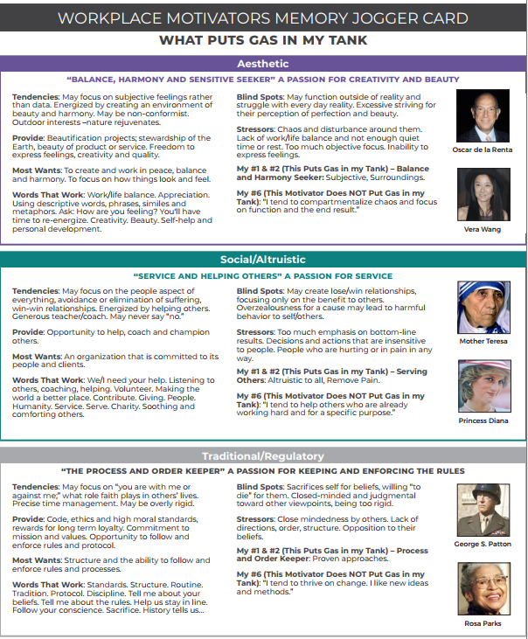
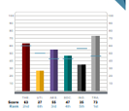
Motivators Memory Jogger Card
1) Read the Sections Related to Your Most Interested, #1 &#2 Motivators. Pick two statements that stand out and be ready to share. How has this shown up in your life and work?
2) Read the Section Related to Your Least Interested, #6 Motivator. How has this shown up in your life and work?
#1
#2
=
Gas in Tank
#6
=
Empty
Tank
Notes:
Let’s start with you looking for your #1 motivator and top interest . According to the assessment, this is what puts gas in your tank. See where you landed and then review the MJ Card. (Link to the MJ Card: https://wakeupeager.s3.amazonaws.com/Motivators_MJCard_2021.pdf )
(ASK) What insights do you see? Is there anything that seems like “ah-ha” “makes sense” or “well that’s a surprise…” Is anyone willing to share?
Now look for your #2 (ASK) What insights do you see? Is there anything that seems like “ah-ha” “makes sense” or “well that’s a surprise…” Is anyone willing to share?
(ASK) If this is accurate and it is an insight into what fills your tank – how could you use this insight daily? How could you use it on this team?
Now look for your #6 – what you are least motivated by. (SHARE?/ASK) A statement for #6 is the last item listed in each of the motivator descriptors. According to the assessment, this area does not fill your gas tank. In fact, it may cause stress if you must focus on it 5 days a week.
What insights do you see? Is there anything that seems like “ah-ha” “makes sense” or “well that’s a surprise…” Is anyone willing to share?

Slide 18
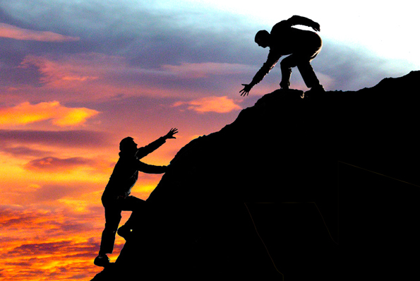
“The person (people) who most influenced my
motivators (my greatest and least interests) may have been…”
Notes:
Your ranking of the motivators, top and least interests, was naturally formed. You were born with these tendencies.
And has also been influenced by your environment.
Reflect on the people or a person who you believe may have most influenced you and your top interests. It may have been someone you admired.
EXAMPLE – your father taught you all to be good Samaritans. He was always volunteering and helping anyone in need, which probably influenced you, as your top interest is Social/Altruistic.
Or maybe your father gave away all family possessions, believing that living on the land and giving to others was the best way to live. While you loved your father, you decided differently. You wanted more stability and to live in a beautiful home. Your father’s example may have influenced your interest in a different path to being Utilitarian/Economic focused.
FACILITATOR NOTES:
A great exercise, if you have time, is to have people break up into groups of three to talk amongst themselves about their answers to this question about who influenced them. We will often have them stand as they have this discussion, and we keep the sharing short to five minutes total.
This exercise reveals that how we scored each of the motivators is influenced by our life experience and is therefore not something that we try to change or make different. We want to learn to appreciate own interests, and appreciate the interests of others, even if we have opposite interests.

Slide 19
For More Gas in Your Tank…
Theoretical/Knowledge. Are you learning new things and able to solve problems every day? Are you working on becoming an expert in something?
Utilitarian/Economic. Are your long hours paying off? Are you able to make more and get more results? Are helping track ROI and eliminate waste of time and resources?
Individualistic/Political. Are you able to lead and be out front? Are you able to advance and receive recognition? In what ways can you be the spokesperson?
Social/Altruistic. Do you have time to coach, counsel, support, and help others? Are you involved in organizations with causes you care about?
Aesthetic. Are you able to have the life balance you need? Are you able to express your creative interests and explore self-improvement?
Traditional/Regulatory. Are you able to enforce order and structure in your world via policy, meetings, processes, and tradition? Are you able to stand by and share your beliefs?
Notes:
To sum up Motivators – make note of the questions next to the areas you scored #1 and #2. Use this self-awareness to manage your energy and motivation. Put more Gas in YOUR Tank, every day.

Slide 20
Personal Reflection Exercise*
1. “I am a (job title) because I…”
2. “I work at (company) because…”
3. “While working at (company) , I want to gain…”
*These answers are private and will not be shared with the group.*
(UTI / AES / IND / SOC / THEO / TRAD))

Slide 21
In summary, what are Workplace Motivators?
The “Why” of our actions
Drives our choices and decisions
Creates engagement when fulfilled
What is automatically important to you
How you judge people or situations (Conflict – Three Reasons…)
The arena in which you like to communicate (‘your peeps’)

Slide 22
‘Gas in Tank’ Tension or Synergy?
ME / ME
Notes:
With awareness of how important our interests are, and how they've been formed over our lifetime, we can better understand when we have internal conflict which we call the Me/Me conflict.
There are three types of conflict that are revealed when we understand our workplace motivators assessment results. The first type of conflict is the Me/Me Conflict.
A good example of a Me/Me conflict would be someone who scored highest in Utilitarian/Economic and Traditional/Regulatory. This person may find that they have a struggle within.
They want to be efficient practical and get results and they want to follow the process procedure and protocol. They may find tension within themselves as they try to decide which to do first be practical or follow a long process. When we understand that both motivators help us be who we are and are some of our greatest strengths we could have less internal tension and more synergy within.
This understanding can reduce internal tension and judgment of self. It can increase awareness of strengths and capability, therefore increasing confidence and reducing struggle.

Slide 23
‘Gas in Tank’ With Others – Tension or Synergy?
ME / YOU
Navigating Situations Outside Your Comfort Zone, pages ___ and ___.
Notes:
The second type of conflict is the Me/You conflict. This type of conflict is when our top interests do not align. Sometimes the Motivator that is across the Wheel from us, can be the viewpoint we have the most challenge with. With understanding – we can reduce the tension and increase the synergy – even though we have different preferences.
For example, someone with a top motivator of Theoretical, which is a love for learning, brings an objective and data-focused approach to problem-solving.
Someone with an aesthetic motivator and interest in balance and harmony may be more subjective and focused on feelings when they solve problems.
They could have tension working together. But, If they understand each other's strengths and potential blind spots, they could create more synergy and make better decisions together.
Another example of a Me/You conflict could be between the person with a focus on Social/Altruistic, who might share, -“People are the most imp, we must remove pain and suffering” and a person with Utilitarian/Economic, who might share, “Yes, I love people too – but we have to get ROI and results, that’s most important.”
Understanding the different interests and motivators of your team, can help you reduce tension and increase synergy, by learning to appreciate how each viewpoint adds value.
You may have the most tension with anyone who’s #1 (their greatest interest) is something you ranked as #6 (your least interest).
Go to Navigating Situations Outside Your Comfort Zone, pages ___ and ___, of your Talent Insights report now to review tips and insights for powerful insight on how to create more synergy and understanding.

Slide 24
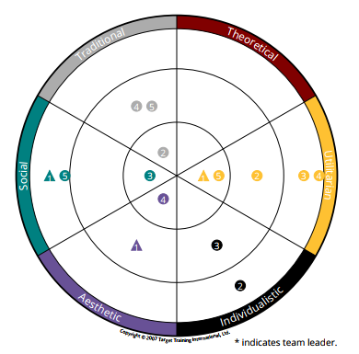

Workplace Motivators: #1 and #2
THE PROCESS AND ORDER KEEPER:
Follow and enforce rules, process, structure.
FACILITATOR NOTE: Insert this team’s motivator wheel onto this page. Notice that we’ve covered up the info on the #6 – that is covered on the next page
THE LEARNER
Always Questioning,
High Product Knowledge.
#1
#2
THE BUSINESS PERSON: R.O.I.: Money, Reduce waste.
ALTRUISTIC/SERVICE/
HELPING OTHERS:
Generous helper,
remove pain.
According to the Assessment:
My #1, #2 =
Most Interested
BALANCE AND
HARMONY SEEKER:
Creativity, beauty,
harmony & balance.
THE POWER PLAYER:
Leading, advancing, influence.
Notes:
FACILITATOR NOTE: Insert the team wheel on this page. Use the white circle the cover the #6, least interest. Cover it on the next slide.
(ASK) Does this work for our team and the work we do?
What strengths does it show that we bring? (refer to Memory Jogger card)
What could be potential blind spots? How are we currently covering the blind spots?
Potential Conflict?
Potential benefit?
What else do we need to be doing more of or less of?

Slide 25
Workplace Motivators: #6
FACILITATOR NOTE – insert the team wheel here too, this slide is for discussing the summary of the team’s #6
THE PROCESS AND ORDER KEEPER:
Follow and enforce rules, process, structure.
THE LEARNER
Always Questioning,
High Product Knowledge.
#6
THE BUSINESS PERSON: R.O.I.: Money, Reduce waste.
ALTRUISTIC/SERVICE/
HELPING OTHERS:
Generous helper,
remove pain.
According to the Assessment:
My #6=
Least Interested
BALANCE AND
HARMONY SEEKER:
Creativity, beauty,
harmony & balance.
THE POWER PLAYER:
Leading, advancing, influence.
Notes:
Let’s look at the Team Overall – the area where the team has the most interest is in
(ASK) Does this work for our team and the work we do? What strengths does it show that we bring? (refer to Memory Jogger card) What could be potential blind spots?
How are we currently covering the blind spots? What else do we need to be doing more of or less of?
The next area is (CHANGE For THE TEAM) (ASK) (CHANGE For EACH TEAM #6 Motivator Here …)
Does this work for our team and the work we do? What strengths does it show that we bring? (refer to Memory Jogger card) What could be potential blind spots?
How are we currently covering the blind spots? What else do we need to be doing more of or less of? Now, let’s look at what each individual rated as their LEAST Interest…
Now let’s look at the third type of conflict – Me/Job.

Slide 26


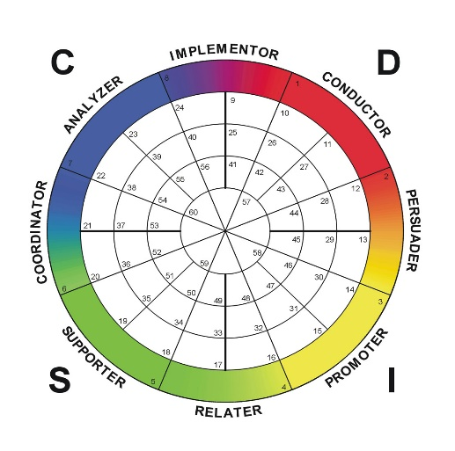
“You’d be perfect,
if you were different …”

Slide 27


Slide 28
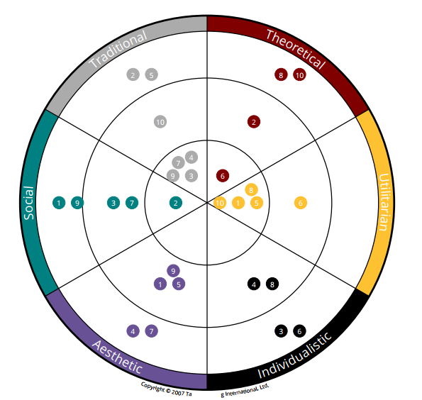

Evolve Your View - See With New Eyes…
Judgment
CONFLICT
Understanding
LESS TENSION
Appreciation
MORE EASE, MORE SHARING
“We use our differences to help each other…”
“You’re just wrong!!”
“We disagree, but now I think I understand why…”
INSERT TEAM WHEEL HERE
Notes:
With this new awareness about your team members – you can move from – you are wrong and you make me crazy! To…

Slide 29
Evolve - See With New Eyes…
Judgment
CONFLICT
Understanding
LESS TENSION
Appreciation
MORE EASE, MORE SHARING
“We use our differences to help each other…”
“You’re just wrong!!”
“We disagree, but now I think I understand why…”
INSERT TEAM WHEEL HERE
Notes:
You can gain a better understanding of who each person is, what their strengths, and begin to understand your different preferences. You can begin to “see with new eyes” And as you apply the tips and insights into your daily interactions…

Slide 30
Evolve - See With New Eyes…
Judgment
CONFLICT
Understanding
LESS TENSION
Appreciation
MORE EASE, MORE SHARING
“We use our differences to help each other…”
“You’re just wrong!!”
“We disagree, but now I think I understand why…”
INSERT TEAM WHEEL HERE
Notes:
And overtime – as your awareness and appreciation of each person – grows. We can stop trying to change the people around us, and we change our complaints about them, and began to truly APPRECIATE each person.

Slide 31
Workplace Motivators Overview
Your #1, #2, (MOST) and #6 (LEAST) are what drives you to act
Not “good or bad” or “right or wrong”
Not about ability, but are about INTEREST
They may reorder as life circumstances change
They reveal what stresses us out and what we can tend to overdo
With awareness, you can manage stress and what you may overdo

Slide 32
The Key to
the Ferrari…
Notes:
There are five strength revealer focus areas.
We use a car analogy to talk about these areas for easy recall and understanding.
This strength revealer model and the car analogy help you focus on the big picture and help you understand the different aspects measured in the assessment. It is an effective way to understand your performance strengths and potential blind spots. And how you can focus and leverage those strengths in your work every day.
The first strength revealer is roads traveled and plans. This focuses on strengths related to your Background, experience, knowledge, and future goals.
The second strength revealer is our communication style. And that is measured in the assessment in the DISC assessment. In the car analogy, this is how you drive. It is what people see – your communication style and interaction behaviors.
The next strength is gas in tank. This is a measurement of your top motivators and interests. This area is not visible to others, but it is essential. It is what makes us want to act. If a car is out of gas, it is not going anywhere. Motivators are what fill our tank.
There's also an area called horsepower, and it is not immediately visible to others but is the engine of performance. It provides a measurement of 20+ personal skills. Some examples would include self-management, teamwork, and leadership.
And the last strength revealer is where you're parked. This is the impact of the organization and the team’s culture, your team’s leadership, and the team’s collaboration and effectiveness.
Today you’ll learn more about your strengths in the areas related to gas and tank, which is the motivators assessment, and how you drive, which is the disc communication style assessment.
Let’s begin learning more about what is measured in the assessment’s Motivators, Gas in Tank. As a reminder, this area reveals what causes you to want to take action – it is, according to the assessment, your WHY.

Slide 33
HOW WE WANT TO INTERACT FIVE DAYS A WEEK…
The Key to
the Ferrari…
Notes:
There are five strength revealers. This Performance Improvement model will help us keep the assessment res(s) in context; It can also help us better understand the different aspects of our performance strengths and potential blind spots.
To make the model easier to recall, we use a car analogy.
The first strength revealer is road travel and future experience, knowledge, and plans. This is your background and education. It also includes where you've been and where you want to go. There are many strengths that you bring to your role in this area.
Another strength revealer area is the DISC assessment, and in the car analogy, it is how we drive. It reveals communication and interaction style strengths. The next area is gas and tank – measuring motivation and interest. This area is not visible to others, but it is essential. It is what makes us want to act. If a car is out of gas, it is not going anywhere. Motivators are what fill our tank.
There's also an area called horsepower, and it is also not visible to others but related to horsepower. It provides a measurement of personal. Some examples would include self-management, teamwork, and leadership.
Lastly, there are strengths on our team and individually where we're parked. The organization’ and the group also impact performance and can be a strength or a blind spot.
I wanted to quickly mention these five areas so that we could keep the assessment(s) we’re reviewing together in context. Now let’s review what’s measured in the DISC assessment. Recall – that this is measuring “How We Drive”

Slide 34
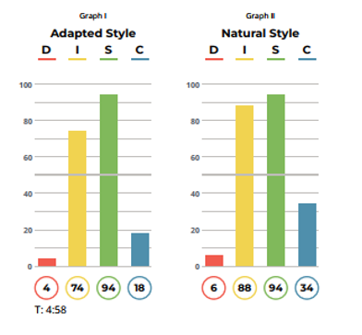
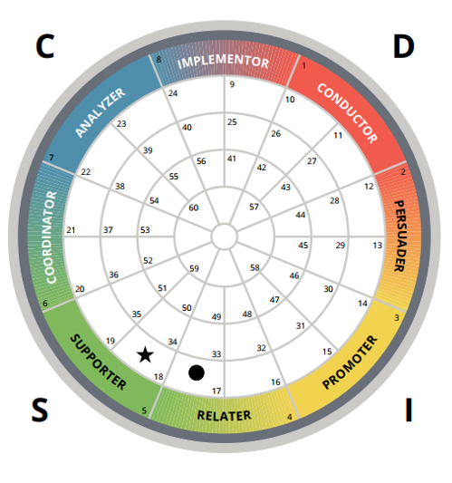
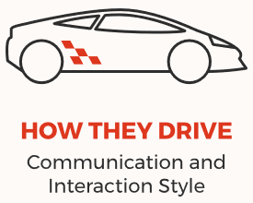
DISC - HOW WE WANT TO INTERACT FIVE DAYS A WEEK…
Notes:
As a reminder – this science measures your behaviors and communication style – what people see. There are four areas – D I S C – and each carries certain characteristics; we are often more than one style – so we use the wheel to show the blending of style.
(Explain each style and hand out the DISC Memory Jogger card.)
Hand out the DISC Communication Style MJ Card. https://s3.amazonaws.com/wakeupeager/MemoryJogger_DISC.pdf

Slide 35
NATURAL STYLE
Nature/Nurture. Developed at Early Age. Not likely to change.
Natural Style –> we are most comfortable here.
If adapting, we will revert to our Natural Style when under stress.
LOOK AT YOUR DISC GRAPH, PAGE ___
What do you score above the ENERGY LINE on the Natural Style?
Energy Line - 50
Notes:
This person scores the S and the I above the energy line. See what you scored above the energy line. (Provide page number for the DISC graph.)
FACILITATOR NOTE – In this team Building session we do not cover the adapted graph discussion, due to the lack of time. If asked abut the Adapted Style – that is how someone may be temporarily (adapting) changing their style to meet current demands on the job. For this exercise we are focused on what the Assessment revealed is their NATURAL strength – how they prefer to behave, interact, and communicate – five days a week.

Slide 36
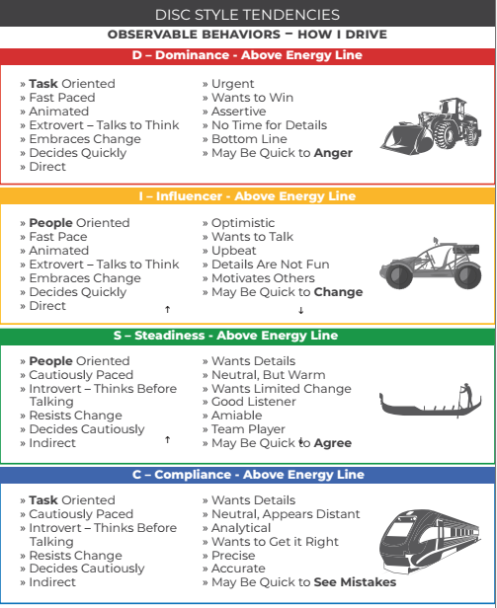
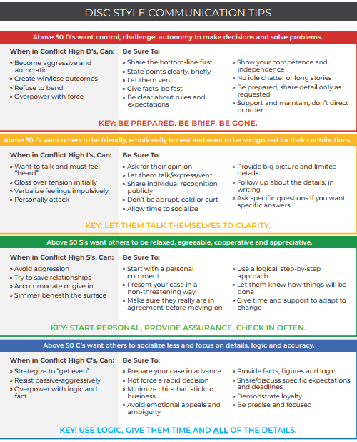
DISC - Memory Jogger Card
STYLE TENDENCIES
COMMUNICATION TIPS
Notes:
In our example – this person has the S (Steadiness) and the I (Influencer) above the energy line. Here we can see that behavior tendencies (Side 1) and Communication Tips (Side 2)
ON THE WHEEL. The circle is your natural style – how you communicate naturally, and if you are under stress, you will use this style because it is natural to you. The star is a snapshot of how you are currently adapting your style at work right now. If you were to retake the assessment at a future time, your natural style would typically stay the same. Your adapted style usually changes depending on your work environment and your current role.
The further out you are on the wheel, the stronger the style tendency is, which means it's more visible to others. For example, this person is a very high S and I (style.
If your style is closer in on the wheel, that is an indication that the person is a mix of styles and that the style tendency will be less noticeable. All placements on the wheel are good because each style combination brings excellent strengths to their work and life. Each style combination can also highlight potential blind spots, typically an overuse of our strengths.
Facilitator Note: Have them open the Memory Jogger card and review the areas Behavior Tendencies and Communication Tips for the areas they scored above the energy line. Review the following slides showing the Observable Behaviors, the Famous People and the humor. Have them refer to the DISC Communication Style MJ Card. https://s3.amazonaws.com/wakeupeager/MemoryJogger_DISC.pdf

Slide 37
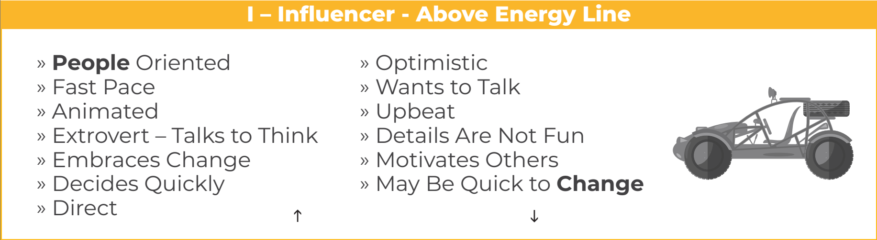


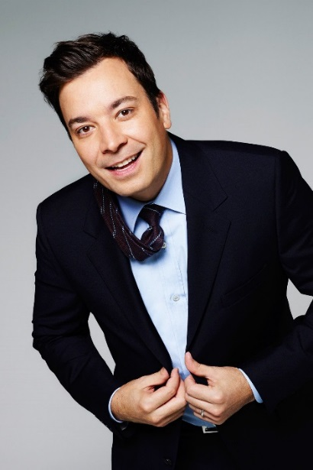
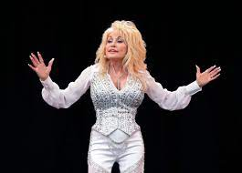

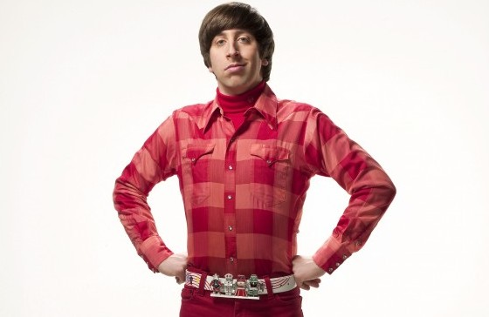
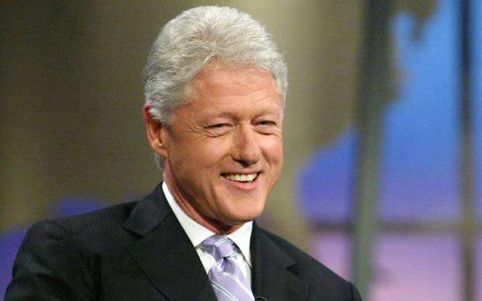
Notes:
If this area is above the energy line for you – can you see this in your interactions? Can you see what these different ‘famous people’ may have in common, behaviorally?

Slide 38
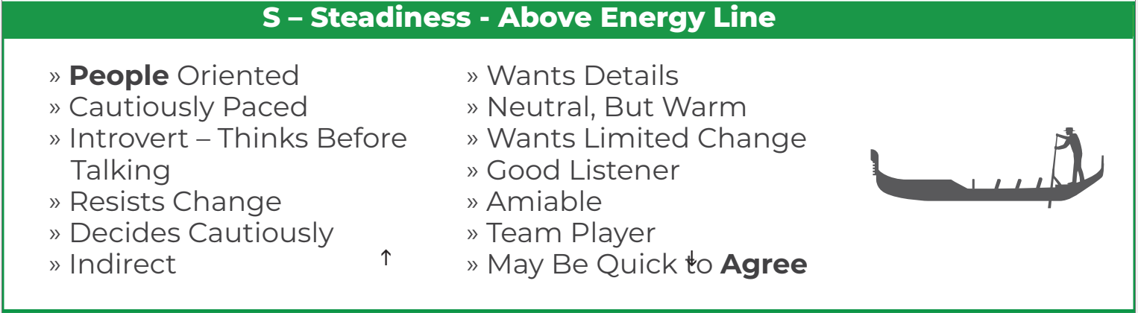

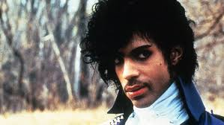
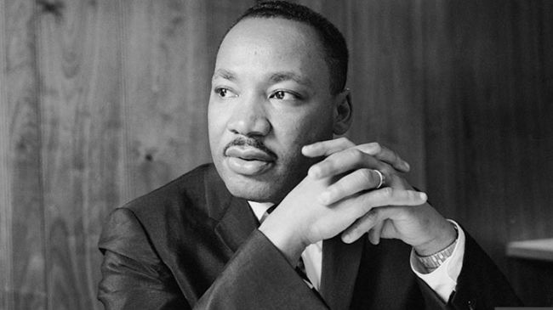
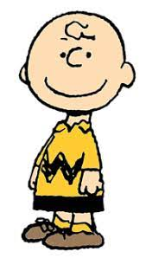

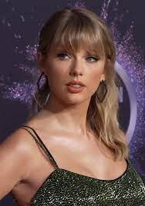


Notes:
If this area is above the energy line for you – can you see this in your interactions? Can you see what these different ‘famous people’ may have in common, behaviorally?

Slide 39


Styles: On the Golf Course…
The D Style may frequently drive through groups of golfers.
The I Style may spend more time in the clubhouse talking than on the course.
The S Style may play golf the same day, the same time, the same place, using the same clubs.
The C Style may keep score, plays strictly by the rules, and clean his or her clubs a lot.
Notes:
The D Style is often in a hurry and can be task oriented. (Think Bulldozer!)
The I style loves to interact and share stories – they can be people oriented and talk to think! (Think – All Terrain Vehicle with lots of friends and making quick changes!)
The S style tends to be steady, and routine-oriented, they can be amiable and agreeable. (Think Gondola – easy, steady, calm, no sudden changes.)
The C style can be analytical, accurate, reserved in demeanor and wants to follow procedure. (Think a Train – that stays on track, and consistently goes from Point A to Point B, without changing course.)

Slide 40
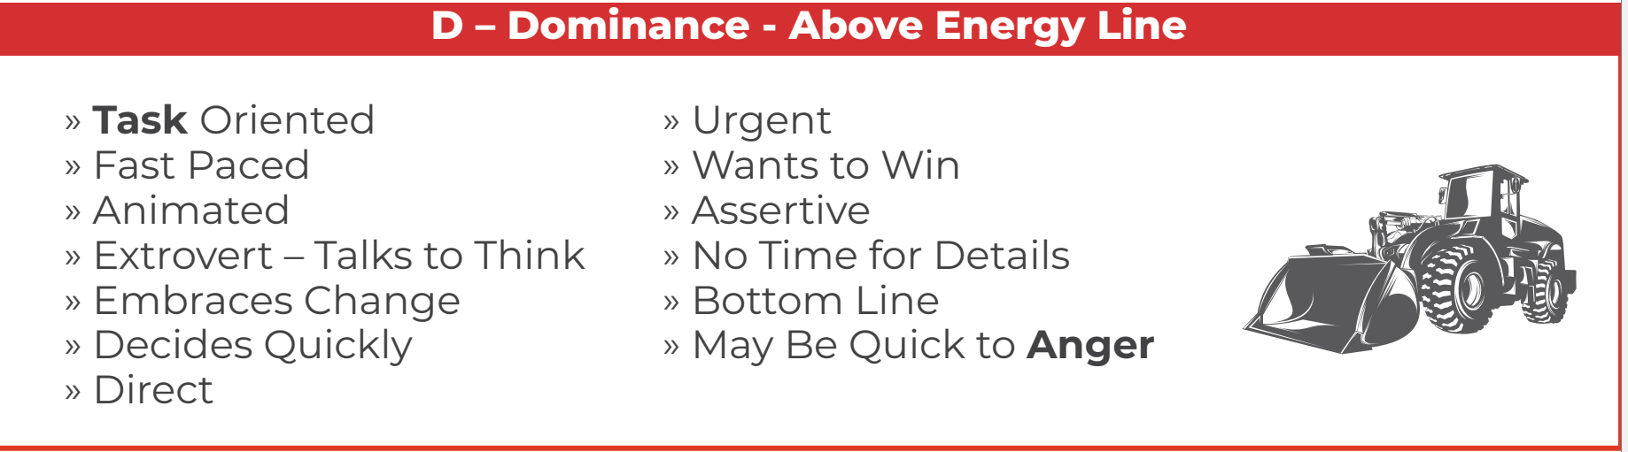

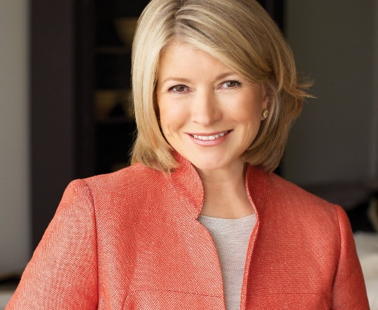
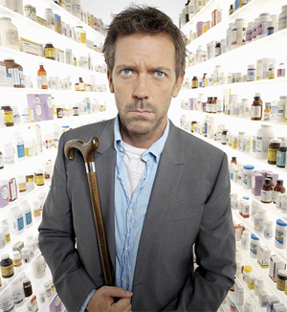



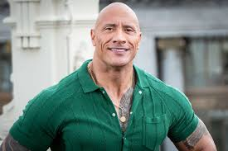
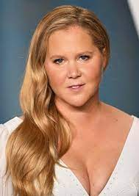
Notes:
If this area is above the energy line for you – can you see this in your interactions? Can you see what these different ‘famous people’ may have in common, behaviorally?

Slide 41
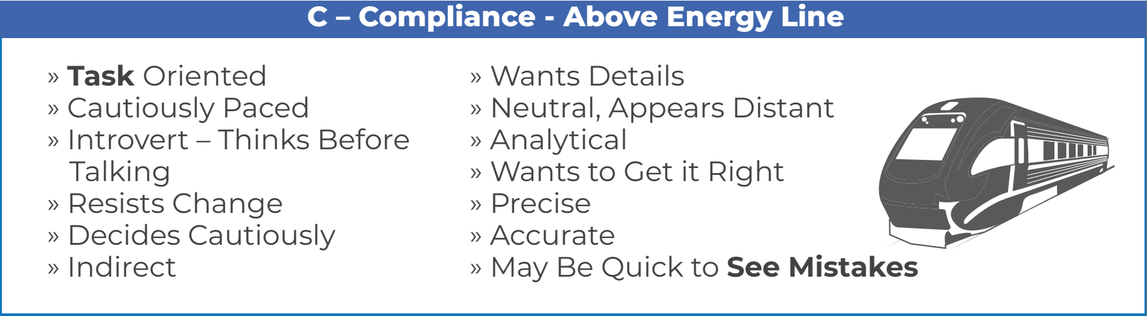



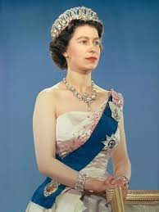
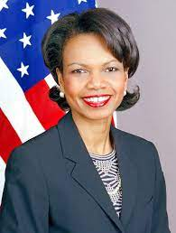
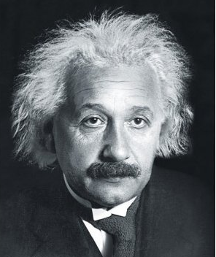


Notes:
If this area is above the energy line for you – can you see this in your interactions? Can you see what these different ‘famous people’ may have in common, behaviorally?

Slide 42
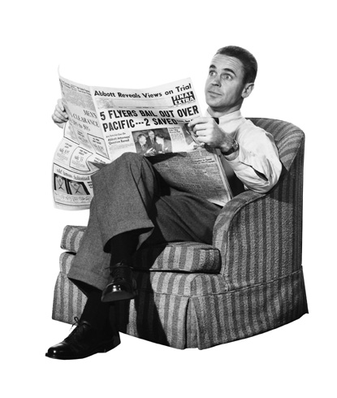
Style: Reading a Newspaper…
The D Style may only read the headlines and scatter the sections in the process.
The I Style may read the obituaries first to see if he knows anyone.
The S Style may read the entire paper and clip interesting articles.
The C Style may call the newspaper if a word is misspelled.

Slide 43
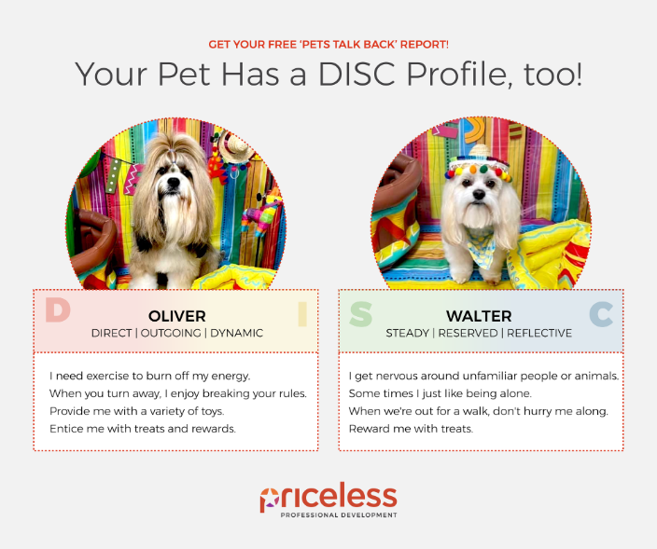
Attention all pet lovers! 🐾
Want to understand your furry friend's personality style?
Look no further than this free DISC report for pets, provided by my assessment partner TTI SI.
It takes less than a minute to complete, and you get the report immediately!
Get your report → https://petstalkback.com/
Notes:
Once you learn DISC styles, you begin to see it everywhere! This Pet DISC tool is fun to do, is free, and only takes about 5 minutes. You get the results immediately and it’s a fun way to apply DISC to our pets, and helps ingrain the learning and our understanding.
FACILITATOR NOTE – if you have a favorite pet – complete the Pet DISC and update these photos. It’s fun and you can share your thoughts.

Slide 44

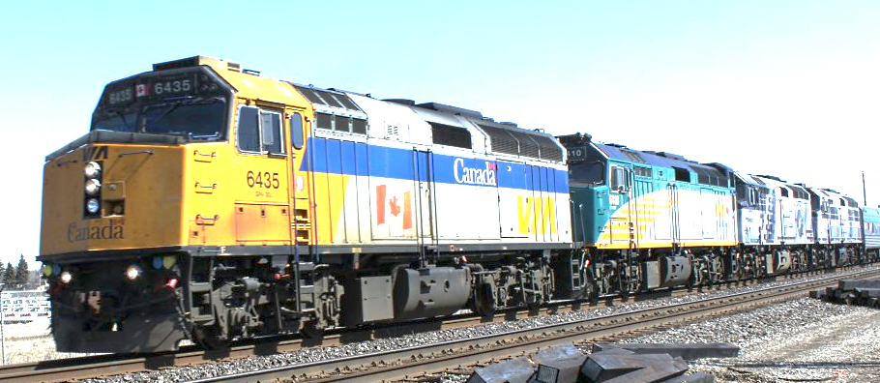




This Group on the Wheel
C
D
Insert this team’s DISC Wheel
S
I
Notes:
FACILITATOR NOTES: A team wheel can be created. (There will be a small administration fee.) We also have DISC Wheel Posters you can hang up and keep. Contact us for more information.
Hand out the DISC Communication Style MJ Card. https://s3.amazonaws.com/wakeupeager/MemoryJogger_DISC.pdf
As a reminder – this science measures your behaviors and communication style – what people see. There are four areas – D I S C – and each carries certain characteristics; we are often more than one style – so we use the wheel to show the blending of style.
All placements on the wheel are good because each style combination brings excellent strengths to their work and life. Each style combination can also highlight potential blind spots, typically an overuse of our strengths.
Another thing to notice about your placement on the wheel is to look at who is across from you. The person with the style combination across from you is someone who has strengths that are very different from your own. This is an opportunity for either great tension or great synergy. There could be tension if you don't understand and appreciate each other’s communication style differences. And synergy if you do appreciate the differences and learn to work together.
The person with style combinations that land on the wheel across from you has strengths that cover your blind spots while your strengths can cover their blind spots.

Slide 45

How You May Be Adapting Your Style for Work…
Moving Toward:
  D = more assertive and challenge oriented
  I = more out-going and trusting
  S = more cautious, slowing down
  C = more focus on procedure & accuracy
Moving Away:
  D = less assertive and challenge oriented
  I = less trusting, guarding what you share
  S = speeding up your activity and pace
  C = less focus on procedures and details
ADAPTING – ASK… Working? Stressful?
Notes:
Now let's look at what adapting your style may indicate.
In this example, the Natural style circle in the Promoter section on the outer edge – indicates that this is a high I (Influence Style).
The Adapted style moves from the outer edge toward the C style. Adapting your style is not good or bad and not adapting your style is not good or bad. It is just a datapoint of information, according to the assessment, on how you are adapting your style at work.
As you can see in the Adapting Guidelines, when you move toward the C style, you are adapting your style to become more focused on procedure and accuracy. You’re also moving away from the high I, an indication that you're less trusting and guarding what you share.
The questions to ask: Are you aware of this adaptation? Is this adaptation of my style causing me stress? Or is it working for the current circumstance at work right now?
And if you are not adapting and your circle and the star are in the same area on the Wheel, you can ask similar questions: Is this working? Do my current circumstances require me to adapt my style?
Have them refer to the DISC Communication Style MJ Card. https://s3.amazonaws.com/wakeupeager/MemoryJogger_DISC.pdf
FACILITATOR NOTES: optional breakout exercise Have people break out into pairs. They can share each their styles with each other, discuss whether they are adapting or not, and the questions: Are you aware of this change in style at work? Is it working? Is it causing me stress? They can come back to the group and share their observations.
FACILITATOR SUPPORT: You can reference for your own knowledge the DISC Adapting Explanations – used in the DISC Graph Reading Flash Card

Slide 46

This Group on the Wheel
Insert this team’s DISC style onto this page.
Notes:
Hand out the DISC Communication Style MJ Card. https://s3.amazonaws.com/wakeupeager/MemoryJogger_DISC.pdf

Slide 47
Which Style Can…
C
Question too much
I
Talk too much
D
Direct too much
S
Agree too much
Notes:
Objective: Awareness of the overextension of each of the behavioral styles
Facilitation
Ask the question
Have group answer
Fill in the correct answer
Transition: Go to next slide

Slide 48
Over-extensions
S
Care more than others think is wise
D
Risk more than others think is safe
I
Dream more than others think is practical
C
Expect more than others think is possible
Notes:
Objective: Awareness that if you overuse one of your strengths it becomes a limitation
Facilitation
Ask the question
Have group answer
Fill in the correct answer
Transition: Go to next slide

Slide 49
Perceptions
If YOU see yourself as
But OTHERS might see you as
Then you are probably a
S
Quiet
Disengaged
C
Conscientious
Fussy
D
In charge
Dominating
I
Convincing
Con artist
Notes:
Objective: Awareness that others don’t always see us the way we see ourselves.
Facilitation
Ask the question
Have group answer
Fill in the correct answer
Transition: Go to next slide

Slide 50
Possible Perceptions
If YOU see yourself as
But OTHERS might see you as
Then you are probably a
D
Confident
Opinionated
C
Organized
Stickler
I
Socially skilled
Long-winded
S
Thoughtful
Slow
Notes:
Objective: Awareness that others don’t always see us the way we see ourselves.
Facilitation
Ask the question
Have group answer
Fill in the correct answer
Transition: Know that we understand the DISC methodology and have identified your personal strengths and limitations, let’s do an exercise that will helps us with one of our development opportunities

Slide 51
Check List For Communicating:
Pick a statement that is helpful to you if others do this when communicating with you…
@ page ___
1. What does the statement you selected mean to you?
2. Why is it important for others to communicate with you in this way?
3. How do we demonstrate we are practicing this communication tip?

Slide 52


Assignment – Create Better Emails
Place link to document in chat or email to participants or if you have time, have them craft an email to someone who’s style is different from their own.
The bottom line for communicating with D-styles:
Get to the point in as few words as possible.
The bottom line for communicating with I-styles: Generate excitement and a sense of collaboration
and fun.
The bottom line for communicating with S-styles:
Be friendly, don’t be pushy, and clearly communicate your expectations.
The bottom line for communicating with a C-styles: Provide all the data and information needed, and time for the reader to process it.
Notes:
Facilitator Note – share this DISC emails document with participants. https://suzies-hard-drive.s3.amazonaws.com/UseDISC-Styles_toCreate_Better_Emails_8_2022.docx Consider a prize for anyone who sends you an email using the tips, or tells you about hos they used the tips – to send an email and the impact it had and difference it made.

Slide 53
Important Pages – Future Meeting Conversations
Ideal Environment: Select a statement you want to share.…
@page __
1. What does the statement mean to you?
2. Why is it important to you that others understand this?
3. How do people demonstrate they are giving you that thing?
4. How does it impact you when that thing is not available?
Keep the focus on appreciating differences by having future sharing sessions from the assessment as icebreakers in meetings….
@page __
Keys to Motivating: Select a statement you want to share.…
1. What does the statement mean to you?
2. Why is it important to you that others understand this?
3. How do people demonstrate they are giving you that thing?
4. How does it impact you when that thing is not available?

Slide 54
The Key to
the Ferrari…
Notes:
There are five strength revealer focus areas.
We use a car analogy to talk about these areas for easy recall and understanding.
This strength revealer model and the car analogy help you focus on the big picture and help you understand the different aspects measured in the assessment. It is an effective way to understand your performance strengths and potential blind spots. And how you can focus and leverage those strengths in your work every day.
The first strength revealer is roads traveled and plans. This focuses on strengths related to your Background, experience, knowledge, and future goals.
The second strength revealer is our communication style. And that is measured in the assessment in the DISC assessment. In the car analogy, this is how you drive. It is what people see – your communication style and interaction behaviors.
The next strength is gas in tank. This is a measurement of your top motivators and interests. This area is not visible to others, but it is essential. It is what makes us want to act. If a car is out of gas, it is not going anywhere. Motivators are what fill our tank.
There's also an area called horsepower, and it is not immediately visible to others but is the engine of performance. It provides a measurement of 20+ personal skills. Some examples would include self-management, teamwork, and leadership.
And the last strength revealer is where you're parked. This is the impact of the organization and the team’s culture, your team’s leadership, and the team’s collaboration and effectiveness.
Today you’ll learn more about your strengths in the areas related to gas and tank, which is the motivators assessment, and how you drive, which is the disc communication style assessment.
Let’s begin learning more about what is measured in the assessment’s Motivators, Gas in Tank. As a reminder, this area reveals what causes you to want to take action – it is, according to the assessment, your WHY.

Slide 55
The Key to
the Ferrari…

Slide 56

@ page ___
Notes:
Review your Personal Skills list. These are considered “under the hood” because they are crucial soft skills that are not immediately visible but can determine whether the ‘car has high or low horsepower’. These skill scores can be improved and development, just like we can “fine tune” an engine for more power, we can grow Personal Skills needed on the job, for more success.
Most people do not score high in every skill. And most jobs require MASTERY OF ONLY SEVEN of these skills. Look at your top skills, are you using them on the job? And for the lower scoring areas, are they required for mastery on your job, and for the positions you want in the future? If so, add these skills to your development plan.

Slide 57




Development Plan Worksheet
TriMetrix University
www.pricelessprofessional.com/myassessment
Notes:
See the self-paced development tools for this area – links can be found at; www.pricelessprofessional.com/myassessment -use the complimentary Development Plan Worksheet and TriMetrix University for solid development resources, for each area. Take advantage of this complimentary resource – available to you any time. Watch the strength revealer video for a reminder of what we covered today or to inform a teammate.

Slide 58
Three out of Four Adults:
  Do not know what their strengths are…
Notes:
Strengths are essential to success. We started with this ---- you now have insights into some of your greatest strengths!
Unfortunately, so many adults do not know their strengths. According to the Gallup organization, three out of four adults cannot name their strengths, and if they don’t know what their strengths are, they're probably not using them on the job every day. It's no surprise that we have so much disengagement at work today.
We want to use these assessment results to help you name and claim your strengths and gain some of the benefits as a team of having everyone use their strengths on the job every day.

Slide 59
“When I get to do what I do best every day…”
8%
6X
44%
3X
38%
Notes:
And, Your strengths matter. You will feel more involved and enthusiastic every day, and have a higher quality of life – now that you know what some of those strengths are – now the job is to put them to work! And if you everyone on your team does this – you have higher customer services scores, and productivity.
According to the Gallup organization’s extensive research:
- When you know what your strengths are, you are 8% more effective and productive than you were before you were not clear on your strengths.
- When you use your strengths on the job every day, you are six times more likely to be engaged in your work, and you're three times more likely to report that you have a high-quality life.
- The Gallup organization also discovered that teams where each member can say that they get to do what they do best every day, Those teams of 25 people have 44% higher customer service scores and 38% higher productivity.
Your Strengths matter, and we're focusing on them today by looking at how this assessment reveals our strengths and how we can understand our different strengths. It also reviews potential blind spots, which are usually overuse of a strength.

Slide 60
The Key to
the Ferrari…
Notes:
There are five strength revealer focus areas.
We use a car analogy to talk about these areas for easy recall and understanding.
This strength revealer model and the car analogy help you focus on the big picture and help you understand the different aspects measured in the assessment. It is an effective way to understand your performance strengths and potential blind spots. And how you can focus and leverage those strengths in your work every day.
The first strength revealer is roads traveled and plans. This focuses on strengths related to your Background, experience, knowledge, and future goals.
The second strength revealer is our communication style. And that is measured in the assessment in the DISC assessment. In the car analogy, this is how you drive. It is what people see – your communication style and interaction behaviors.
The next strength is gas in tank. This is a measurement of your top motivators and interests. This area is not visible to others, but it is essential. It is what makes us want to act. If a car is out of gas, it is not going anywhere. Motivators are what fill our tank.
There's also an area called horsepower, and it is not immediately visible to others but is the engine of performance. It provides a measurement of 20+ personal skills. Some examples would include self-management, teamwork, and leadership.
And the last strength revealer is where you're parked. This is the impact of the organization and the team’s culture, your team’s leadership, and the team’s collaboration and effectiveness.
Today you’ll learn more about your strengths in the areas related to gas and tank, which is the motivators assessment, and how you drive, which is the disc communication style assessment.
Let’s begin learning more about what is measured in the assessment’s Motivators, Gas in Tank. As a reminder, this area reveals what causes you to want to take action – it is, according to the assessment, your WHY.

Slide 61
“You’d be perfect,
if you were different …”

Slide 62


Slide 63
What is normal for you and your team is…
enthusiasm.
laughing a lot, many times a day.
to feel strong, sure, confident, and secure.
to have so much energy at the end of the day that
you're looking for more good things to do.
to have such passion for life that when you're with other people,
you're eager to hear about what they're doing and how they're doing it.
to have so much energy at the end of the day, you’re
already eagerly planning tomorrow.
feeling disappointed that the sun goes down and
enthusiastic that the sun comes up.
Notes:
When we use our strengths – we can create something special –you can Wake Up Eager, be a Wake Up Eager Leader and Teammate and create a Wake Up Eager Team! And if you do – days like this will feel NORMAL!

Slide 64
This is what was most useful to me today…
Here’s one area of expansion for me…
Here’s one action step I will tomorrow…
Notes:
In addition to the Gallup studies about the importance of using our strengths on the job every day – you learned more about your strengths. We covered – how Workplace Motivators reveal our top interests and can help us reduce tension and judgement and increase appreciation for difference in interests. We covered about the characteristics, strengths and potential “over dos’ of our DISC Communication style, you have two Memory Joggers for reference, the DISC emails tips sheet, and access to 100’s of self-paced development resources at www.pricelessprofessional.com/myassessment ---- out of all that we covered today –
What did you find most useful?
2) What’s one area of expansion?
3) What’s one action step you will take tomorrow?

Slide 65

Appreciation for Each Other…
30 seconds of silence.
Share “Thank You Notes”
Examples:
“Thank you for making that comment about___ it helped me…”
“Thank you for doing ___ today, I like how you…”
“I appreciate this about you ______ because…”

Slide 66
How to Use Your TriMetrix Results to Win at Work, Life, and on the Team

Slide 67

Title Slide
Notes:
(INTRO) Today we’re going together for a team building tune up!
(ENERGIZE - WHY THIS MATTERS TO YOU, WHY YOU ARE HAPPY/EXCITED TO BE THERE – SHOW ENERGY)
I’m excited to show you how to better understand your own and teammate’s strengths and potential growth areas.
(EMPOWER – WHAT THEY WILL GET FROM THIS SESSION)
You are going to be able to use this information to learn how to leverage each other’s top talents, cover each other’s blind spots and overall work together more effectively and ENJOY working together, even more!
Our Agenda today will be to review the top motivators and communication style of the team and then review individual and team Strengths and Growth Edges. (Opportunities)

