Slide 1


How to Use Your TriMetrix Results to Win at Work and Life

Slide 2
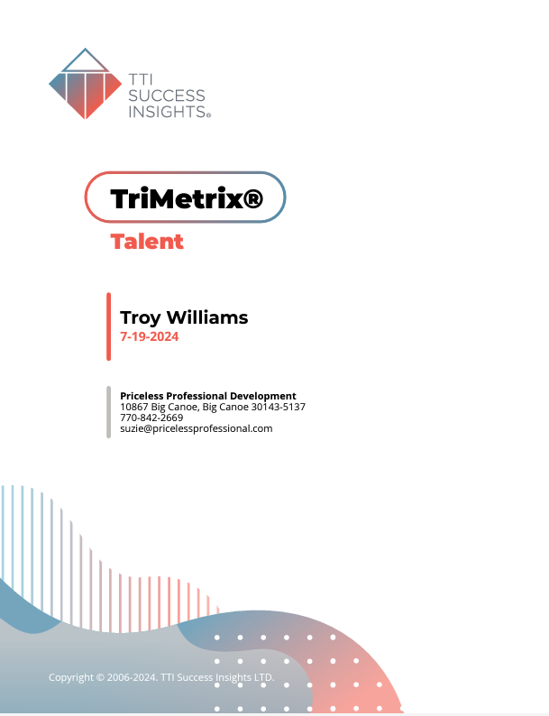
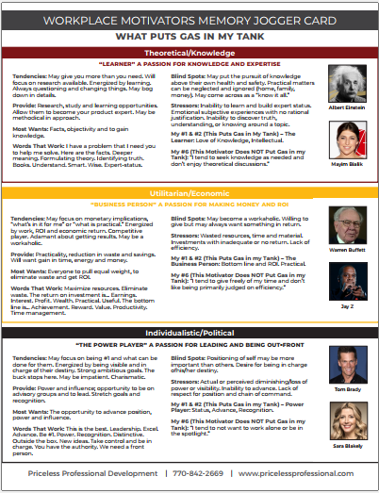
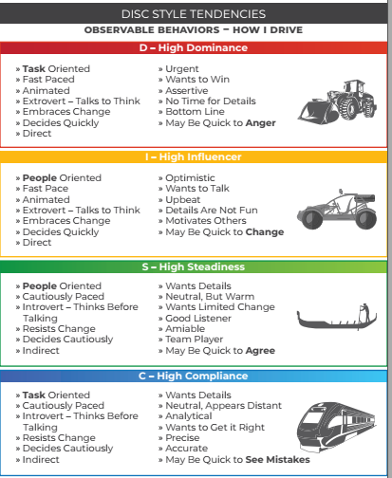
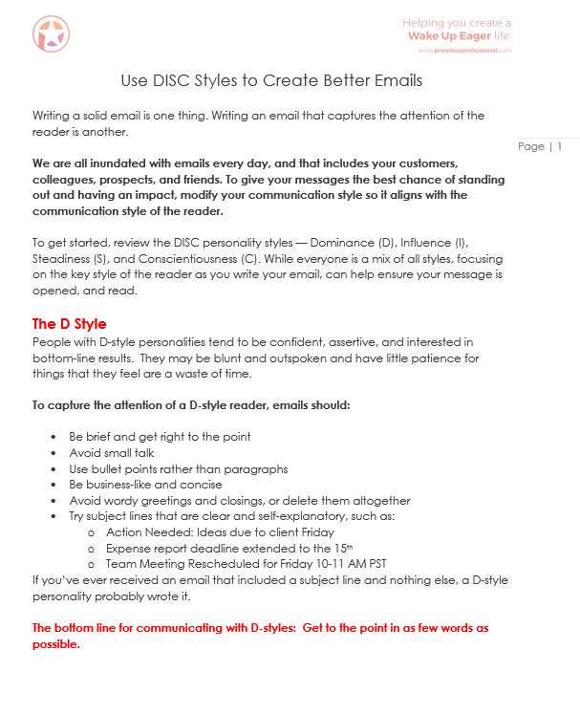
What We’ll Reference Today…

Slide 3
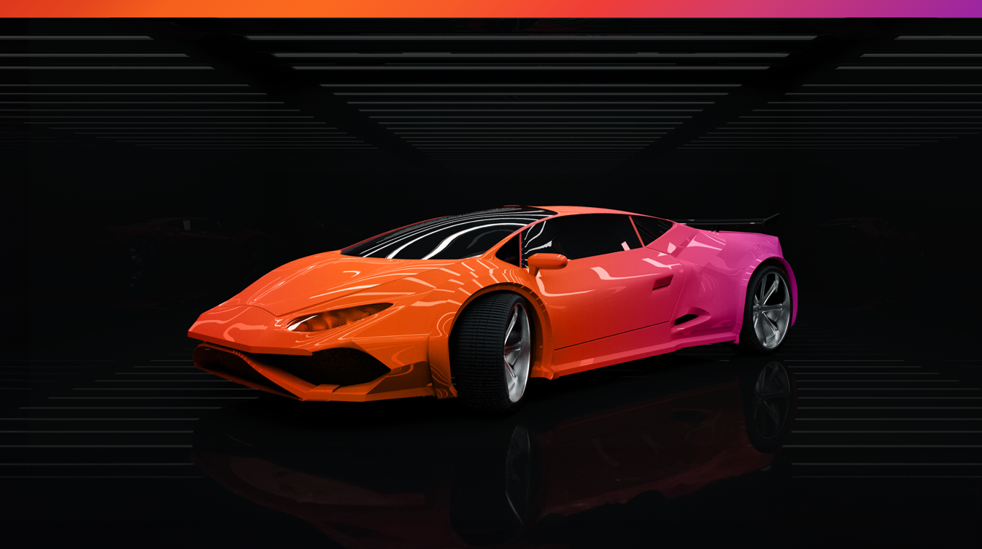
“When I get to do what I do best every day…”
44%
6X
3X
38%

Slide 4
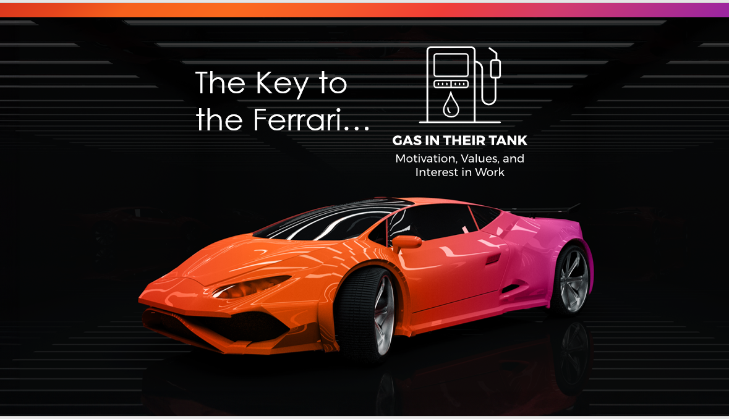


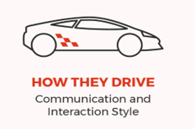


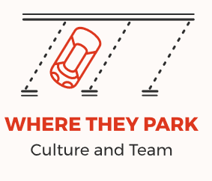
The Key to
the Ferrari…
THE KEYS TO THE FERRARI

Slide 5
WHAT WE WANT TO DO FIVE DAYS A WEEK…
The Key to
the Ferrari…

Slide 6


So, what are Workplace Motivators?
The “Why” of our actions
Drives our choices and decisions
Creates engagement when fulfilled
What is automatically important to you/everyone
How you/others judge people or situations
The arena in which you/others like to spend time(‘our peeps’)

Slide 7
Sad News
to Share…
The Key to
the Ferrari…

Slide 8
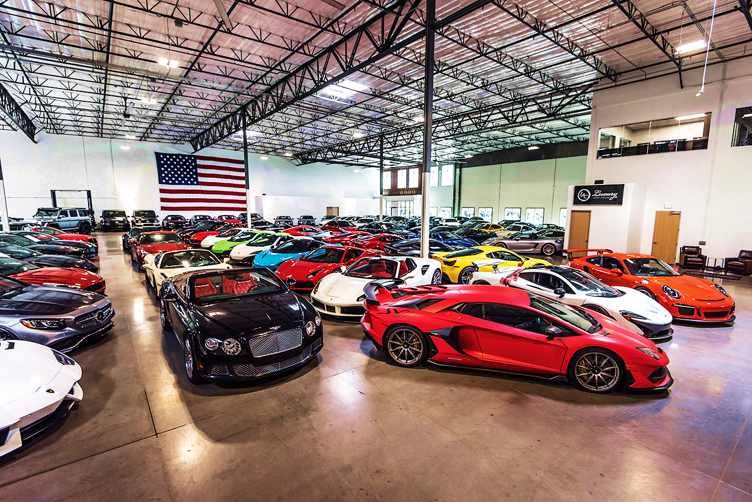
You just inherited his $25M car collection…
What are some of the first actions you will take?
Notes:
Note: this exercise doesn’t have a worksheet – discussion
Objective: To give participants an example of how the Driving Forces may play out in am imaginary scenario
Facilitation:
Ask participants, “If you inherited a $5 million dollar art collection: What are your first thoughts? What would you do with it?”
Have them share with a partner and then discuss as a large group
Answer: most likely one of your primary Drivers Ex. Sell it/Resourceful, Study it/Intellectual, give to a museum/Harmonious.
Transition: Now let’s discuss some of the benefits of understanding Driving Forces

Slide 9
You just inherited his $25M car collection…
WHAT WILL YOU DO?
SIX OPTIONS:
Please select one of
these six options that
feels most like you.
Notes:
Note: this exercise doesn’t have a worksheet – discussion
Objective: To give participants an example of how the Driving Forces may play out in am imaginary scenario
Facilitation:
Ask participants, “If you inherited a $5 million dollar art collection: What are your first thoughts? What would you do with it?”
Have them share with a partner and then discuss as a large group
Answer: most likely one of your primary Drivers Ex. Sell it/Resourceful, Study it/Intellectual, give to a museum/Harmonious.
Transition: Now let’s discuss some of the benefits of understanding Driving Forces

Slide 10
The Action That Is Most on My Mind Right Now Is…
(There is NO RIGHT or WRONG ANSWER.)
#1
#3
#5
Become An Expert.
Learn everything I can about owning a collection. Research the cars. Subscribe to collector magazines and forums.
Give Away – Remove the Pain & Suffering of Others.
Talk to the charity I help on the weekends, and my neighbor who’s struggling.
Join a Race Car
Club.
Become a race car driver!
Get the Collection & myself featured in magazines.
#2
#4
#6
Determine the Rules
& Regs on Owning.
Get with
Insurance and Tax People
Create a system for tracking and maintaining.
Determine the Net Value.
Keep the cars that will grow in value, sell the rest. Meet with my financial advisor on how to best invest the proceeds.
Enjoy Them! Drive the
Beautiful Ones on the Coast.
Get them photographed – they are works of art!

Slide 11
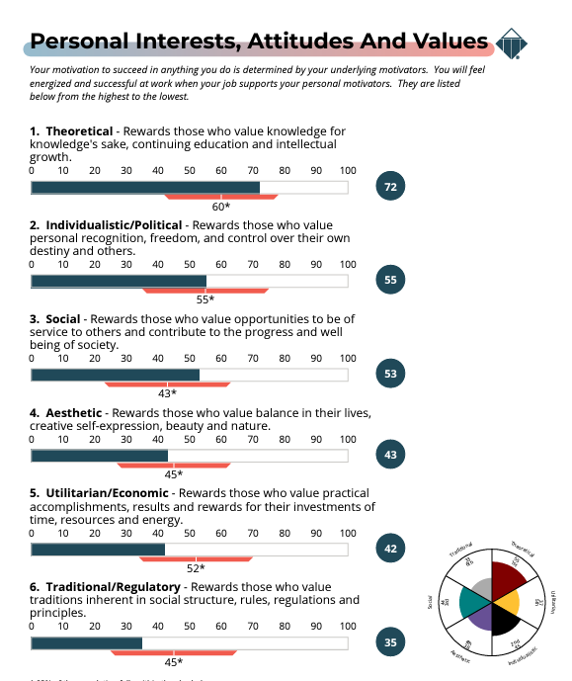
Your Top Interests – Are What Puts “Gas in Your Tank” and Some of Your Greatest Strengths…
Your Turn!
Go To Page 8
Note Your MOST Interested: #1, #2
Note Your LEAST Interested: #6

Slide 12

A Look at Your Motivators
Your #1, #2, (MOST) and #6 (LEAST) are what drives you to act
Not “good or bad” or “right or wrong”
Not about ability, but are about INTEREST
They may reorder as life circumstances change
They reveal what stresses us out and what we can tend to overdo
With awareness, you can manage stress and what you may overdo

Slide 13
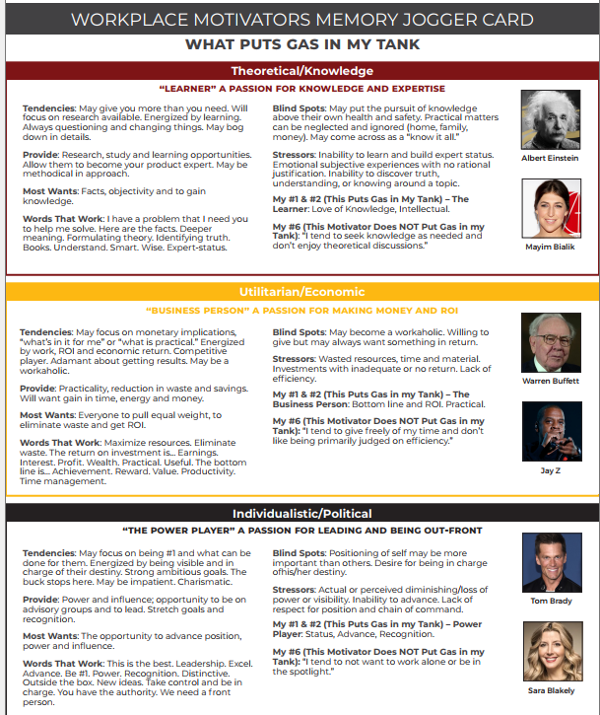
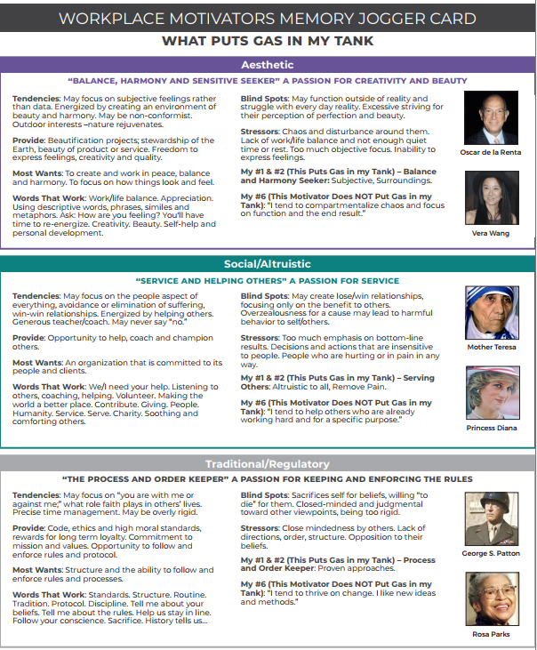
Read the Section
Related to Your Most Interested, #1 #2 Motivators.
Pick a statement that stands out. Think about how this shows up in your life and work
Read the Section Related to Your Least Interested, #6 Motivator.
Think about how this shows up in your life and work?
#1
#2
#6
WHAT WE WANT TO DO FIVE DAYS A WEEK…

Slide 14
Workplace Motivators, in a practical way, provide a common language for understanding and discussing differences.
It helps us understand and benefit from the
value of different opinions and priorities, which also helps us understand the value of every relationship.

Slide 15
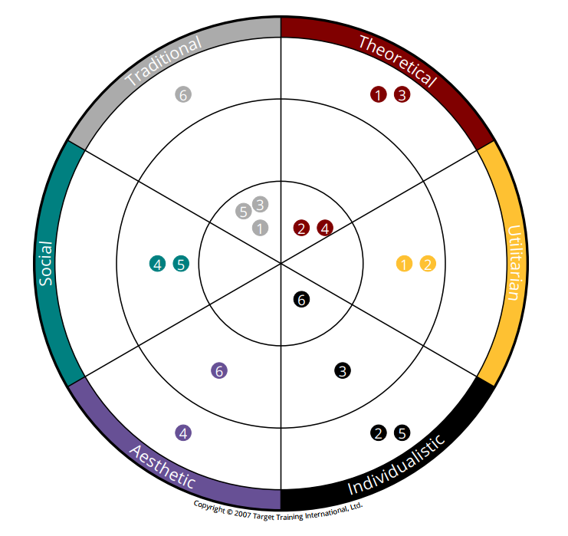
Workplace Motivators: #1 and #2
THE PROCESS AND ORDER KEEPER:
Follow and enforce rules, process, structure.
THE LEARNER
Always Questioning,
High Product Knowledge.
#1
#2
THE BUSINESS PERSON: R.O.I.: Money, Reduce waste.
ALTRUISTIC/SERVICE/
HELPING OTHERS:
Generous helper,
remove pain.
According to the Assessment:
My #1, #2 =
Most Interested
BALANCE AND
HARMONY SEEKER:
Creativity, beauty,
harmony & balance.
THE POWER PLAYER:
Leading, advancing, influence.
Notes:
Let’s start with you looking for your #1 motivator and interest . According to the assessment, this is what puts gas in your tank. See where you landed and then review the MJ Card.
(ASK) What insights do you see? Is there anything that seems like “ah-ha” “makes sense” or “well that’s a surprise…” Anyone willing to share?
Now look for your #2 (ASK) What insights do you see? Is there anything that seems like “ah-ha” “makes sense” or “well that’s a surprise…” Anyone willing to share?
(ASK) If this is accurate and it is insight into what fills your tank – how could you use this insight daily? How could you use it on this team?
Let’s look at the Team Overall – the area where the team has the most interest is in (CHANGE For EACH TEAM -Theoretical/Knowledge…) (ASK) Does this work for our team and the work we do? What strengths does it show that we bring? (refer to Memory Jogger card) What could be potential blind spots? How are we currently covering the blind spots? What else do we need to be doing more of or less of?
The next area is (CHANGE For THE TEAM) (ASK) Individualistic/Political the Power Player - Does this work for our team and the work we do? What strengths does it show that we bring? (refer to Memory Jogger card) What could be potential blind spots? How are we currently covering the blind spots? What else do we need to be doing more of or less of? Now, let’s look at what each individual rated as their LEAST Interest…

Slide 16
Workplace Motivators: #6
THE PROCESS AND ORDER KEEPER:
Follow and enforce rules, process, structure.
THE LEARNER
Always Questioning,
High Product Knowledge.
#1
#2
THE BUSINESS PERSON: R.O.I.: Money, Reduce waste.
ALTRUISTIC/SERVICE/
HELPING OTHERS:
Generous helper,
remove pain.
#6
According to the Assessment:
My #1, #2 =
Most Interested
BALANCE AND
HARMONY SEEKER:
Creativity, beauty,
harmony & balance.
THE POWER PLAYER:
Leading, advancing, influence.
Notes:
Let’s start with you looking for your #1 motivator and interest . According to the assessment, this is what puts gas in your tank. See where you landed and then review the MJ Card.
(ASK) What insights do you see? Is there anything that seems like “ah-ha” “makes sense” or “well that’s a surprise…” Anyone willing to share?
Now look for your #2 (ASK) What insights do you see? Is there anything that seems like “ah-ha” “makes sense” or “well that’s a surprise…” Anyone willing to share?
(ASK) If this is accurate and it is insight into what fills your tank – how could you use this insight daily? How could you use it on this team?
Let’s look at the Team Overall – the area where the team has the most interest is in (CHANGE For EACH TEAM -Theoretical/Knowledge…) (ASK) Does this work for our team and the work we do? What strengths does it show that we bring? (refer to Memory Jogger card) What could be potential blind spots? How are we currently covering the blind spots? What else do we need to be doing more of or less of?
The next area is (CHANGE For THE TEAM) (ASK) Individualistic/Political the Power Player - Does this work for our team and the work we do? What strengths does it show that we bring? (refer to Memory Jogger card) What could be potential blind spots? How are we currently covering the blind spots? What else do we need to be doing more of or less of? Now, let’s look at what each individual rated as their LEAST Interest…

Slide 17
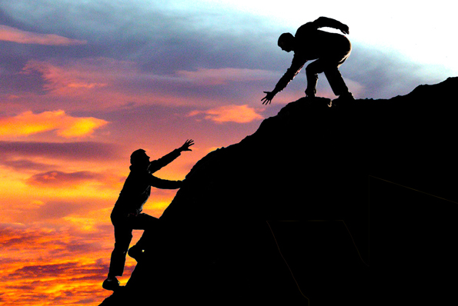
SUGGESTED EXERCISE:
“The person (people) who most influenced my top
motivators may have been…”

Slide 18
The Key to
the Ferrari…
THE KEYS TO THE FERRARI

Slide 19
HOW WE WANT INTERACT FIVE DAYS A WEEK…
The Key to
the Ferrari…

Slide 20
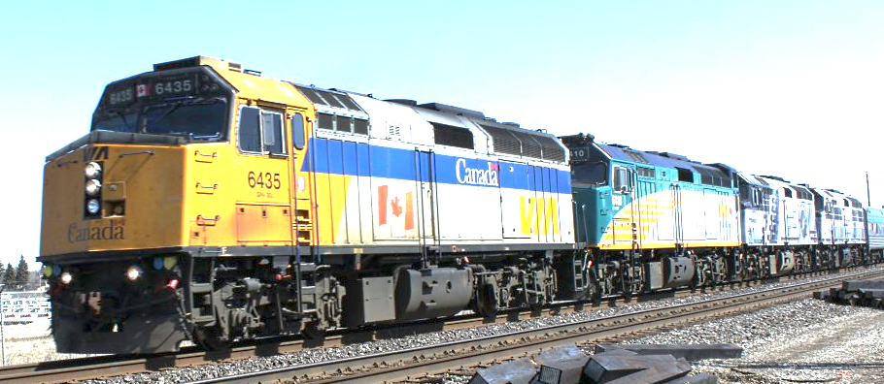
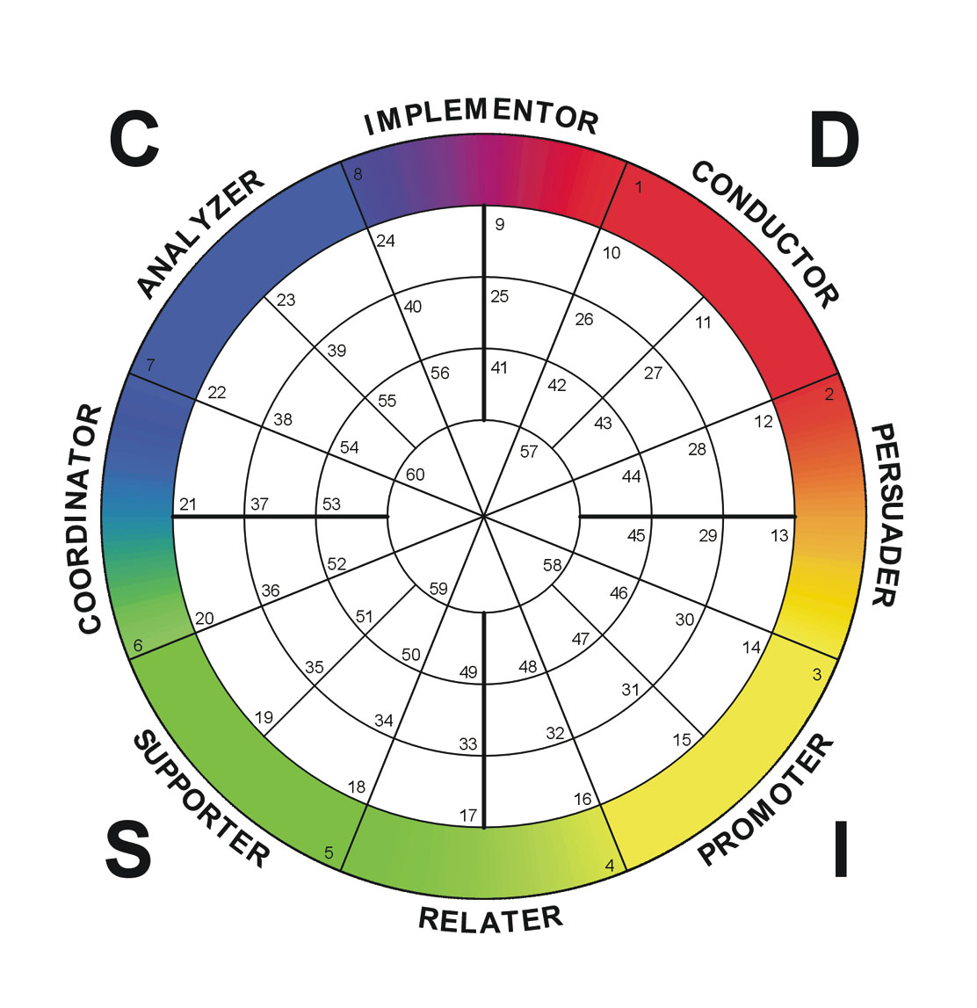

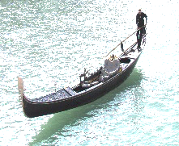
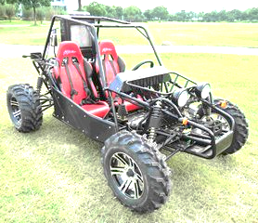
Communication Style: DISC Assessment
Communication Style
What You May See…
Notes:
Hand out the DISC Communication Style MJ Card. https://s3.amazonaws.com/wakeupeager/MemoryJogger_DISC.pdf
As a reminder – this science measures your behaviors and communication style – what people see. There are four areas – D I S C – and each carries certain characteristics; we are often more than one style – so we use the wheel to show the blending of style.
Go to page 24 in your Coaching Report. The circle is your natural style – how you communicate naturally, and if you are under stress, you will use this style, because it is natural to you. The star is a snap short of how you are currently adapting your style, at work, right now.
Do you have your place on the wheel? Pay most attention to your Natural Style.

Slide 21
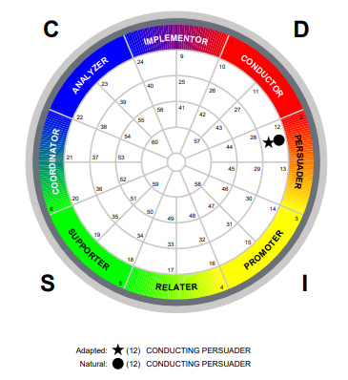
Communication Style: DISC Assessment
Your turn… @ page 5
Wheel, Lower Right
Notes:
Hand out the DISC Communication Style MJ Card. https://s3.amazonaws.com/wakeupeager/MemoryJogger_DISC.pdf
As a reminder – this science measures your behaviors and communication style – what people see. There are four areas – D I S C – and each carries certain characteristics; we are often more than one style – so we use the wheel to show the blending of style.
Go to page 24 in your Coaching Report. The circle is your natural style – how you communicate naturally, and if you are under stress, you will use this style, because it is natural to you. The star is a snap short of how you are currently adapting your style, at work, right now.
Do you have your place on the wheel? Pay most attention to your Natural Style.

Slide 22

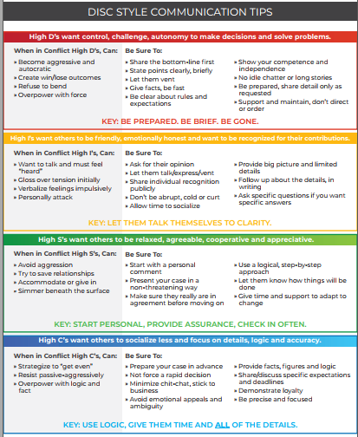
DISC -Memory Jogger Card
STYLE TENDENCIES
COMMUNICATION TIPS

Slide 23
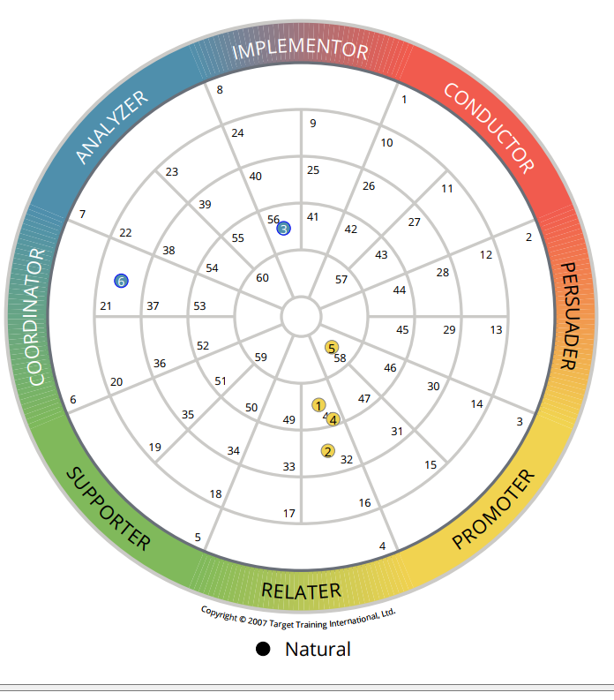
his Group on the DISC Wheel
Notes:
Hand out the DISC Communication Style MJ Card. https://s3.amazonaws.com/wakeupeager/MemoryJogger_DISC.pdf
As a reminder – this science measures your behaviors and communication style – what people see. There are four areas – D I S C – and each carries certain characteristics; we are often more than one style – so we use the wheel to show the blending of style.
Go to page 24 in your Coaching Report. The circle is your natural style – how you communicate naturally, and if you are under stress, you will use this style, because it is natural to you. The star is a snap short of how you are currently adapting your style, at work, right now.
Do you have your place on the wheel? Pay most attention to your Natural Style.

Slide 25

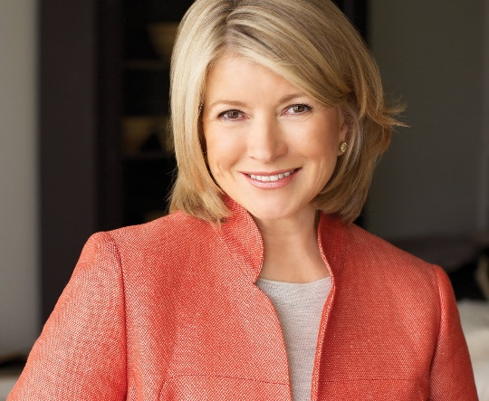
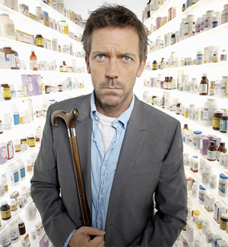
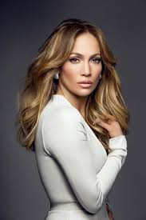

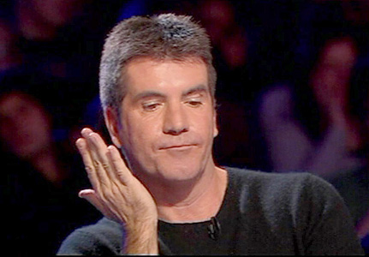
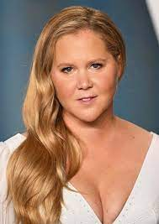

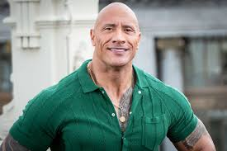
D – What Do They Want & What is the Key:
Notes:
Objective: To view and discuss some famous people that have D as their primary style
Facilitation:
Review who they are [Clockwise from top left]
Donald Trump
Gregory House (House)
Martha Stewart
Simon Cowell
Gordon Ramsey (Hell’s Kitchen, etc.)
Madonna
Ask what they see as their greatest strengths and what others might criticism them for
Transition: Let’s take some time to do a little self-discovery about our D factor

Slide 26
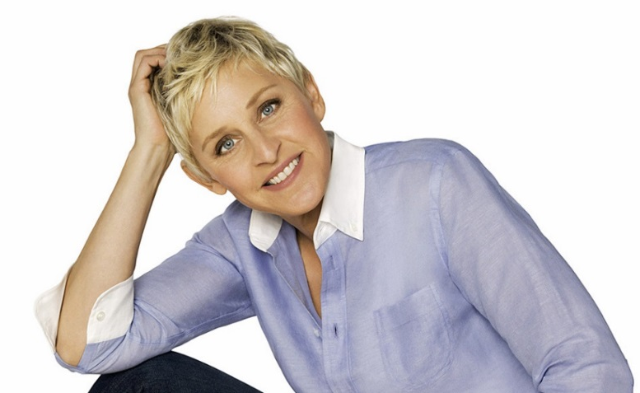
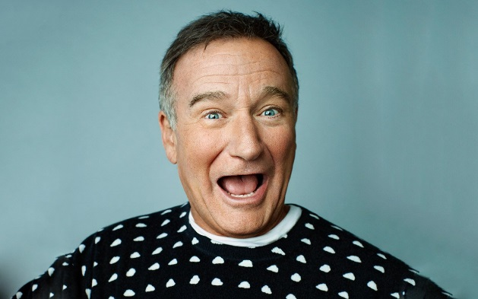
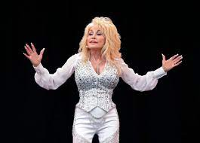
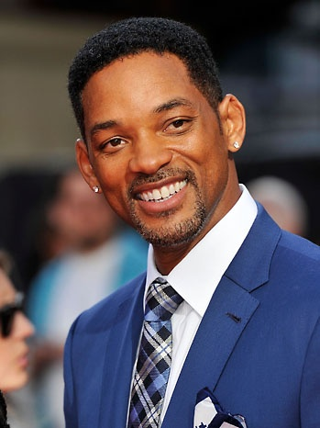
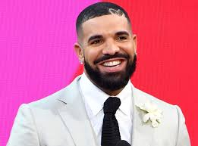
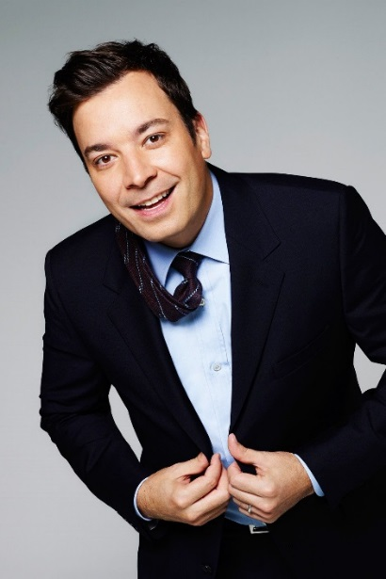
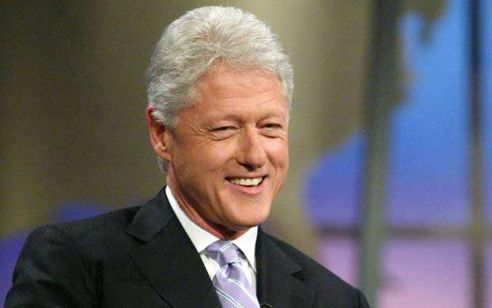
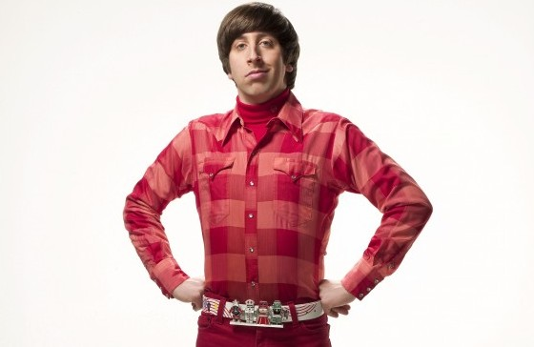
I - What Do They Want & What is the Key:
Notes:
Objective: To view and discuss some famous people that have I as their primary style
Facilitation:
Review who they are [Clockwise from top left]
Ellen Degeneres
Robin Williams
Jimmy Fallon
Howard Wolowitz (Big Bang Theory)
Bill Clinton
Will Smith
Ask what they see as their greatest strengths and what others might criticize them for
Transition: Let’s take some time to do a little self-discovery about our I factor

Slide 27
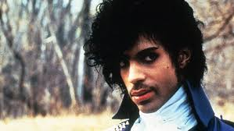
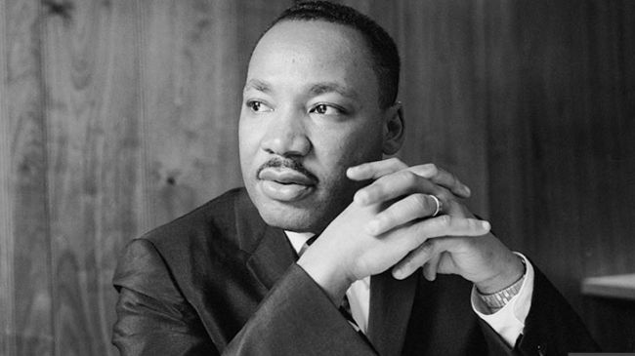
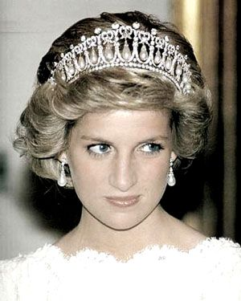

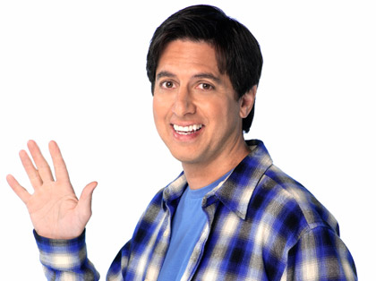
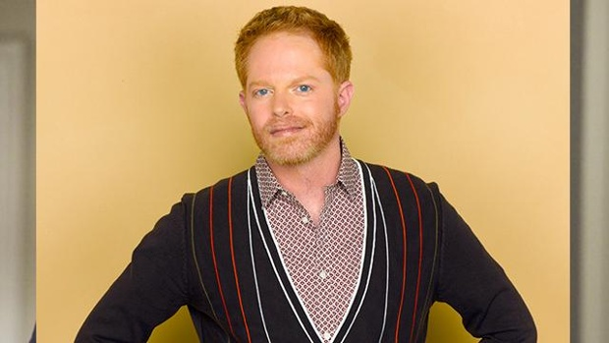
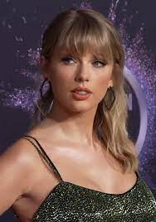
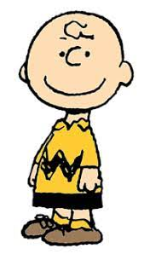

S - What Do They Want & What is the Key:
Notes:
Objective: To view and discuss some famous people that have S as their primary style
Facilitation:
Review who they are [Clockwise from top left]
Martin Luther King, Jr.
Princess Diana
Raj Koothrappali (Big Bang Theory)
Mister Rogers
Ray Romano (Everybody Loves Raymond)
Mitchell Pritchett (Modern Family)
Ask what they see as their greatest strengths and what others might criticism them for
Transition: Let’s take some time to do a little self-discovery about our S factor

Slide 28
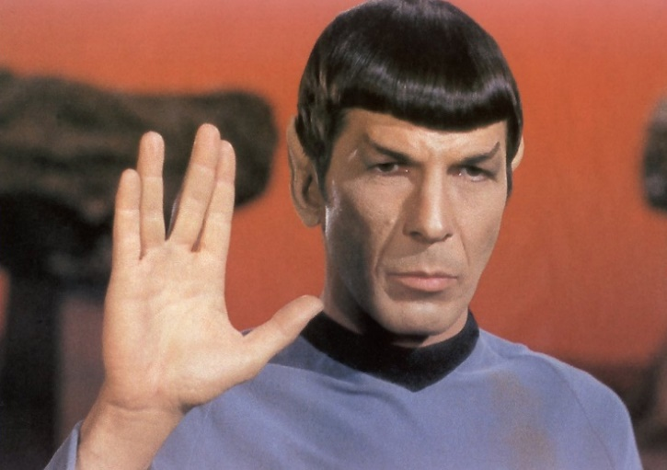

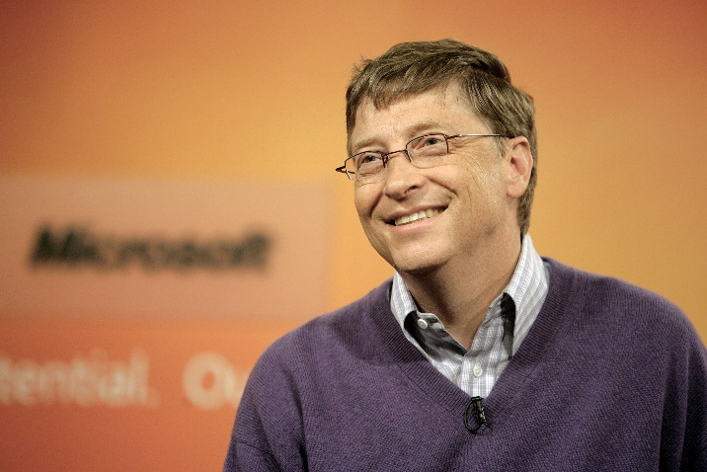
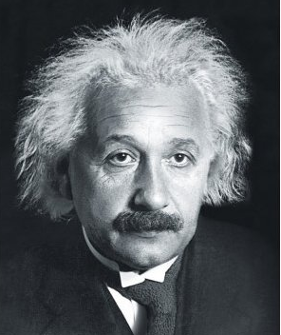
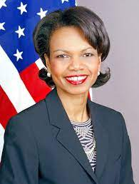


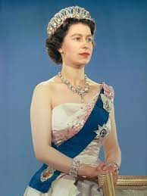
C - What Do They Want & What is the Key:
Notes:
Objective: To view and discuss some famous people that have C as their primary style
Facilitation:
Review who they are [Clockwise from top left]
Spock (Star Trek)
Albert Einstein
Tina Fey
Sheldon Cooper (Big Bang Theory)
Bill Gates
Alex Dunphy (Modern Family)
Ask what they see as their greatest strengths and what others might criticism them for
Transition: Let’s take some time to do a little self-discovery about our C factor

Slide 29
Assignment – Create Better Emails
The bottom line for communicating with D-styles:
Get to the point in as few words as possible.
The bottom line for communicating with I-styles: Generate excitement and a sense of collaboration
and fun.
The bottom line for communicating with S-styles:
Be friendly, don’t be pushy, and clearly communicate your expectations.
The bottom line for communicating with a C-styles: Provide all the data and information needed, and time for the reader to process it.

Slide 30
OUR CURRENT PERSONAL STRENGTHS AND POTENTIAL GAPS…
The Key to
the Ferrari…

Slide 31
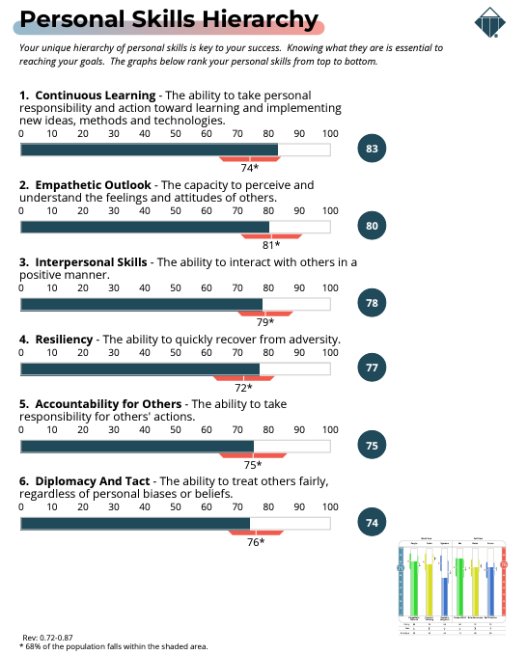
23 Personal Skills – Starting on Page 10

Slide 32
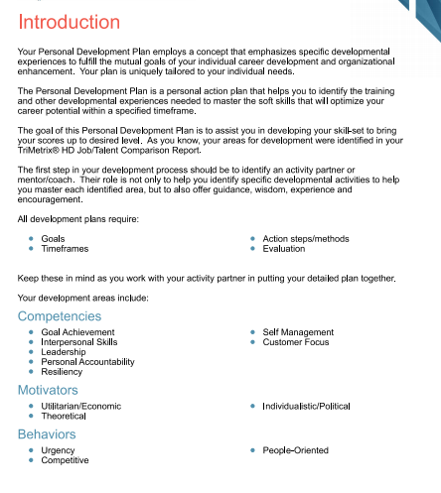
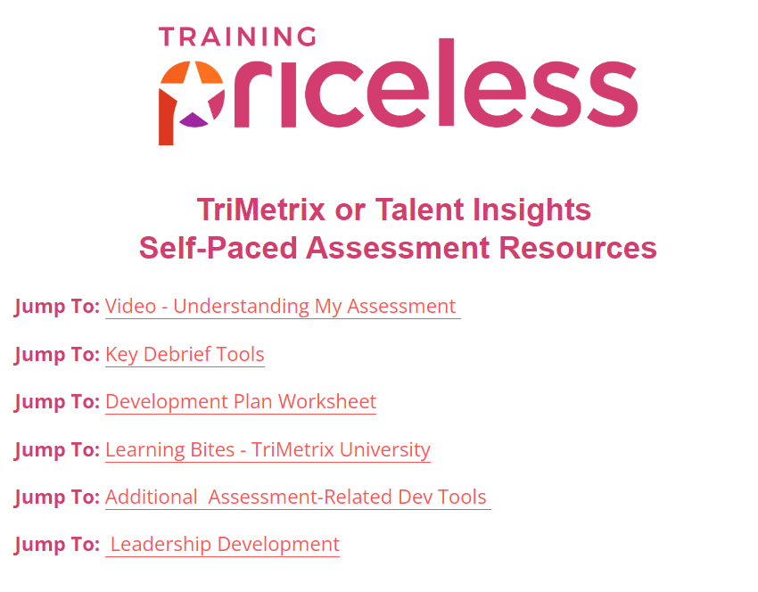


Development Plan Worksheet
TriMetrix University
www.pricelessprofessional.com/myassessment

Slide 33


Slide 34





Debrief Video:
www.pricelessprofessional.com/myassessment

Slide 35
This is what was most useful to me today…
Here’s one area of expansion for me…

Slide 36
How to Use Your TriMetrix Results to Win at Work and Life

